Slide 1
WALTER

Slide 2
WALTER

Slide 3
Trajectory
Planning
visualization
Trajectory Execution
Kinematics
(Webserver)
Angle Interpolation,
Motor and sensor control
Servo
Trajectory Planner
Visual UI
Animation
openGL
Glut, GLUI
Trajectory Board
Odroid XU4
Linux C++
Mongoose Webserver
Cortex
Arm Cortex M4 Realtime C++
Send Angle
via UART
Run
control
loop at
100 Hz
Stepper
Send full trajectory of support points
Send joint angles at 10Hz
Send PWM
Encoder
receive angle
P
+
I
+
D
Define trajectory with support points
Interpolate curve via bezier curve and compute kinematics
Control servos and encoders, compute speed profile and implement feedback-loop of actuators

Slide 4
Power Supply
5V 4A
Power Supply
9V 1A
Power Supply
24V 10A
Power Supply
Trajectory
Execution
Kinematics
Micro
angle
Interpolation
Stepper
Driver (PiBot)
Stepper Hip
126 Ncm, 2.8A
Rotary Encoder
ASM 5048
Trajectory Board
Odroid XU4 Linux, C++
Transfer angles
at 10Hz via UART
Cortex
ARM Cortex M4
Bare Metal C++
Stepper
Driver (PiBot)
Stepper Upperarm
310 Ncm, 3.5A
Rotary Encoder
ASM 5048
Log/txt via serial
Stepper
Driver (PiBot)
Stepper Forearm
190 Ncm, 1.4A
Rotary Encoder
ASM 5048
Trajectory
Planning
Visualization
100 Hz
closed loop
Stepper
Driver (PiBot)
Stepper Ellbow 26 Ncm, 0,4A
Rotary Encoder
ASM 5048
Trajectory Planner
Visual UI
Animation
openGL
Stepper
Driver (PiBot)
Stepper Wrist
40 Ncm, 0.4A
Rotary Encoder
ASM 5048
current pose
Webserver
trajectories
Serial herkulex protocol
Servo Hand
DRS 101
9V 1A
Serial herkulex protocol
Servo Gripper
DRS 101
9V 1A
I²C
Bot Electronics
Bot Mechanics

Slide 5
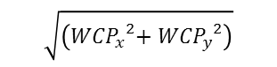
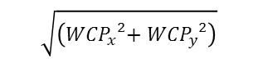
Solution I:
Solution II:
a
β
ellbow
ellbow
β
θ₂
γ
a
c
b
c
WCP_{z}-d₀
θ₁
γ
WCP_{z}-d₀
θ₁
θ₂
α
α
b
δ
δ
$$\sqrt{\left({{WCP}_{x}}^{2}{{+ WCP}_{y}}^{2}\right)}$$
$$\sqrt{\left({{WCP}_{x}}^{2}{{+ WCP}_{y}}^{2}\right)}$$
forward

Slide 6
Computing support points of a cubic bezier curve
A‘
A‘ := A mirrored at B
B‘ := angle bisector of BA‘ and BC with length |BC|/3
B‘
C‘
C
B
A
D
y
top view
y
top view
WCP
WCP
ellbow
θ₀
θ₀
x
x
ellbow

Slide 7
Walter‘s Cortex
ARM M4 (Teensy 3.5)
Realtime C++
closed loop runnig with 100 Hz
to-be angles
and commands
at 10 Hz
via UART
PID controller
to-be angles
PINs
Direction
Pulse
Enable
Command Receiver
Herkulex Servo driver
Magnetic Encoder
Reader
Stepper
PWM generator
(AccelStepper)
5x Pibot Stepper Drivers
Bidirectional
Stepper with
4-wires
Log / Uart
HerkuleX
Protocol
Via UART
absolute angle via I²C
Servo
Magnetic
Encoder
ASM AS5048
Stepper

Slide 8
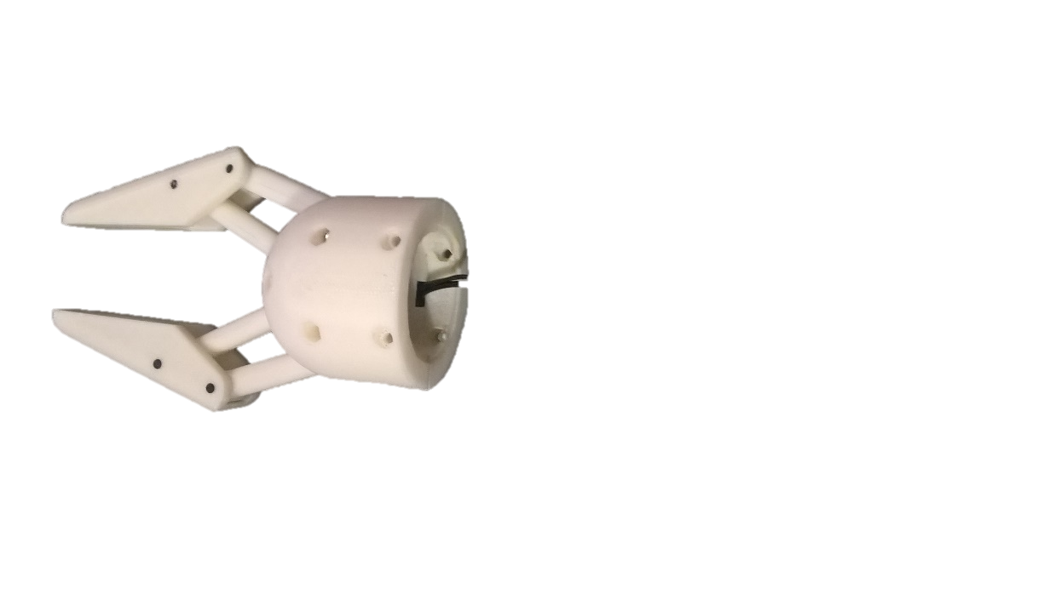
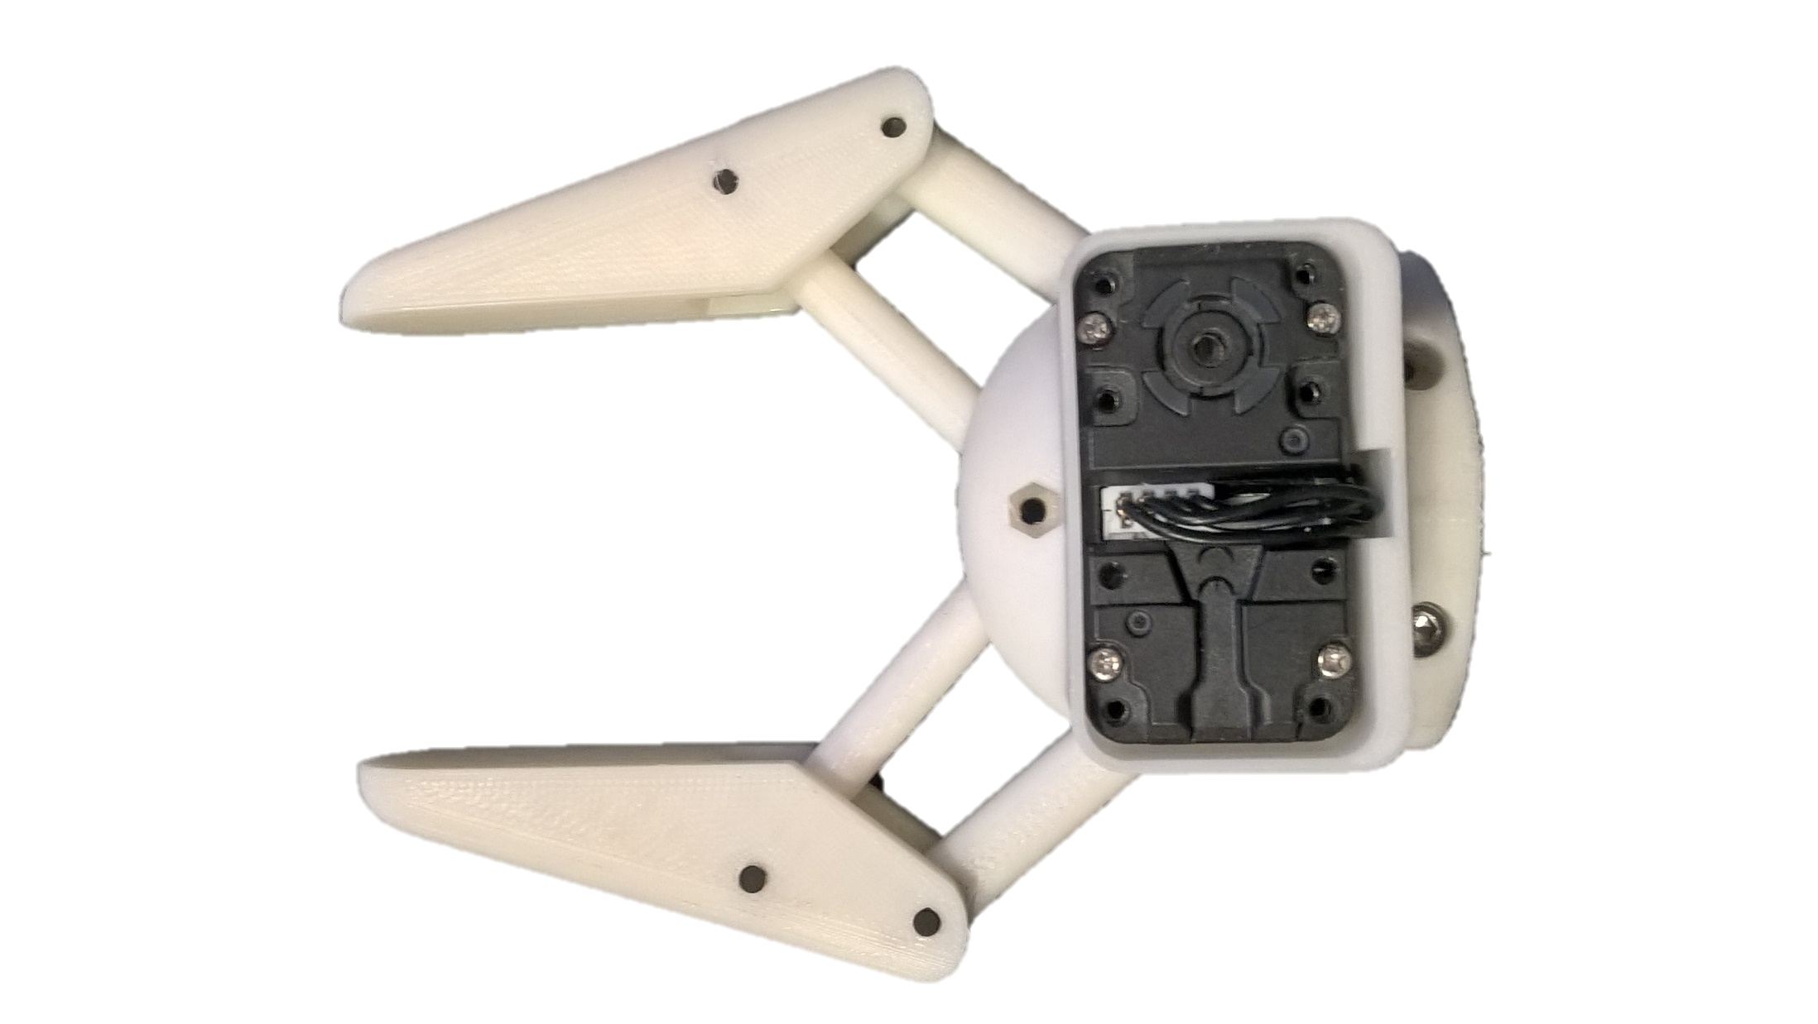
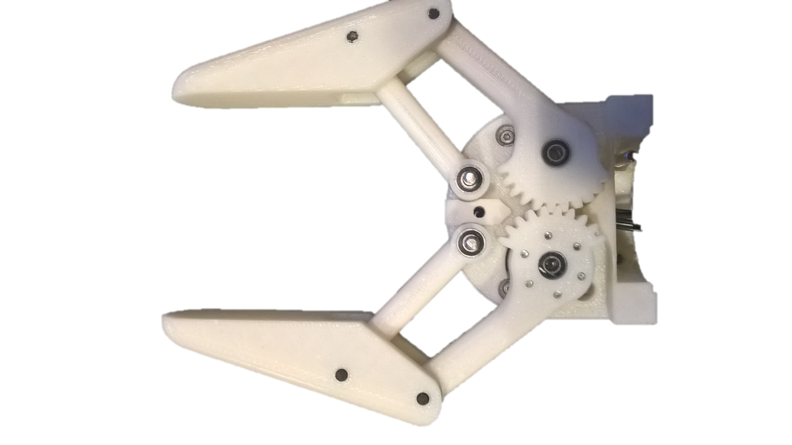

Slide 9
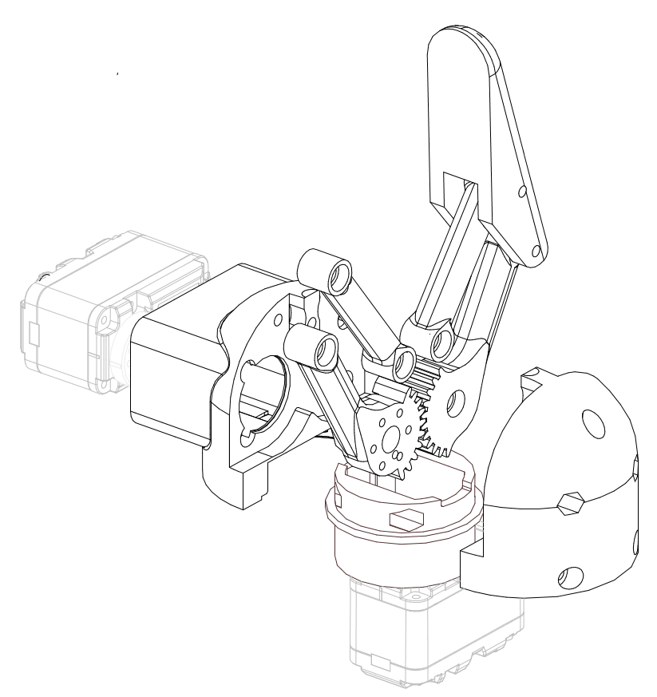

Slide 10
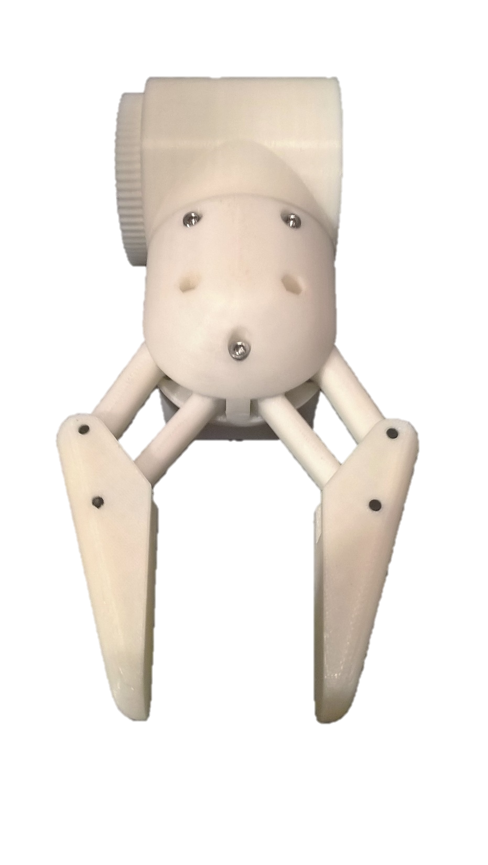
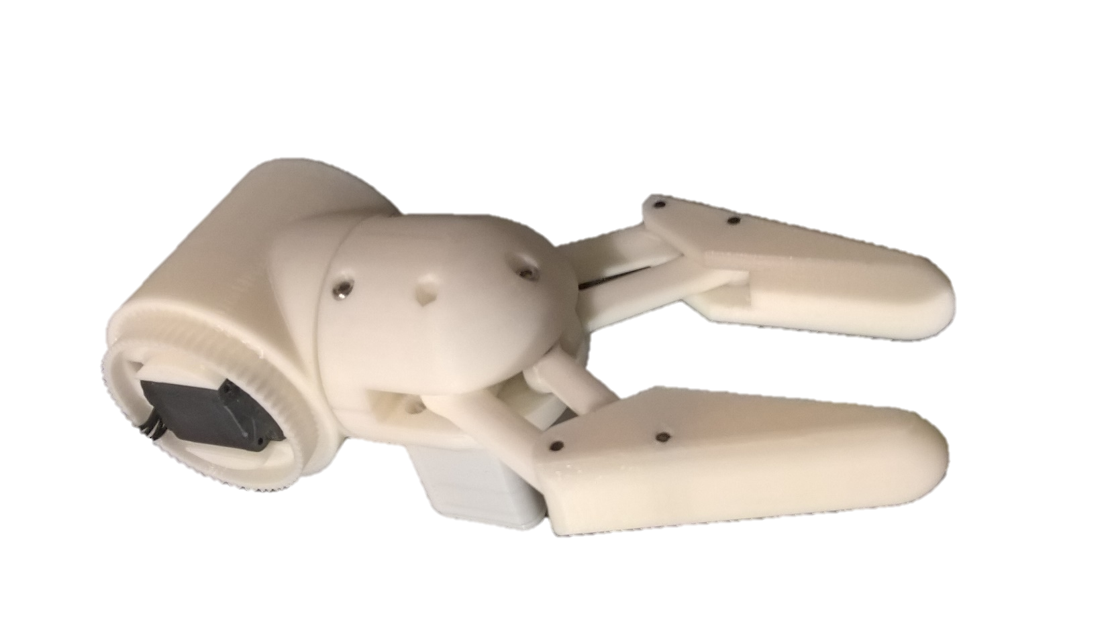

Slide 11
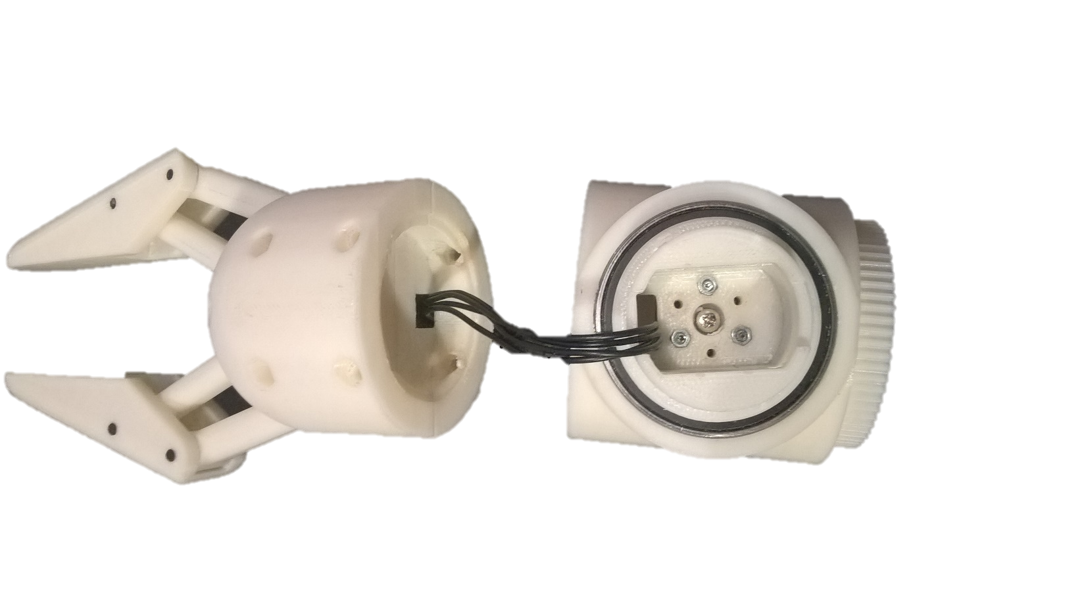
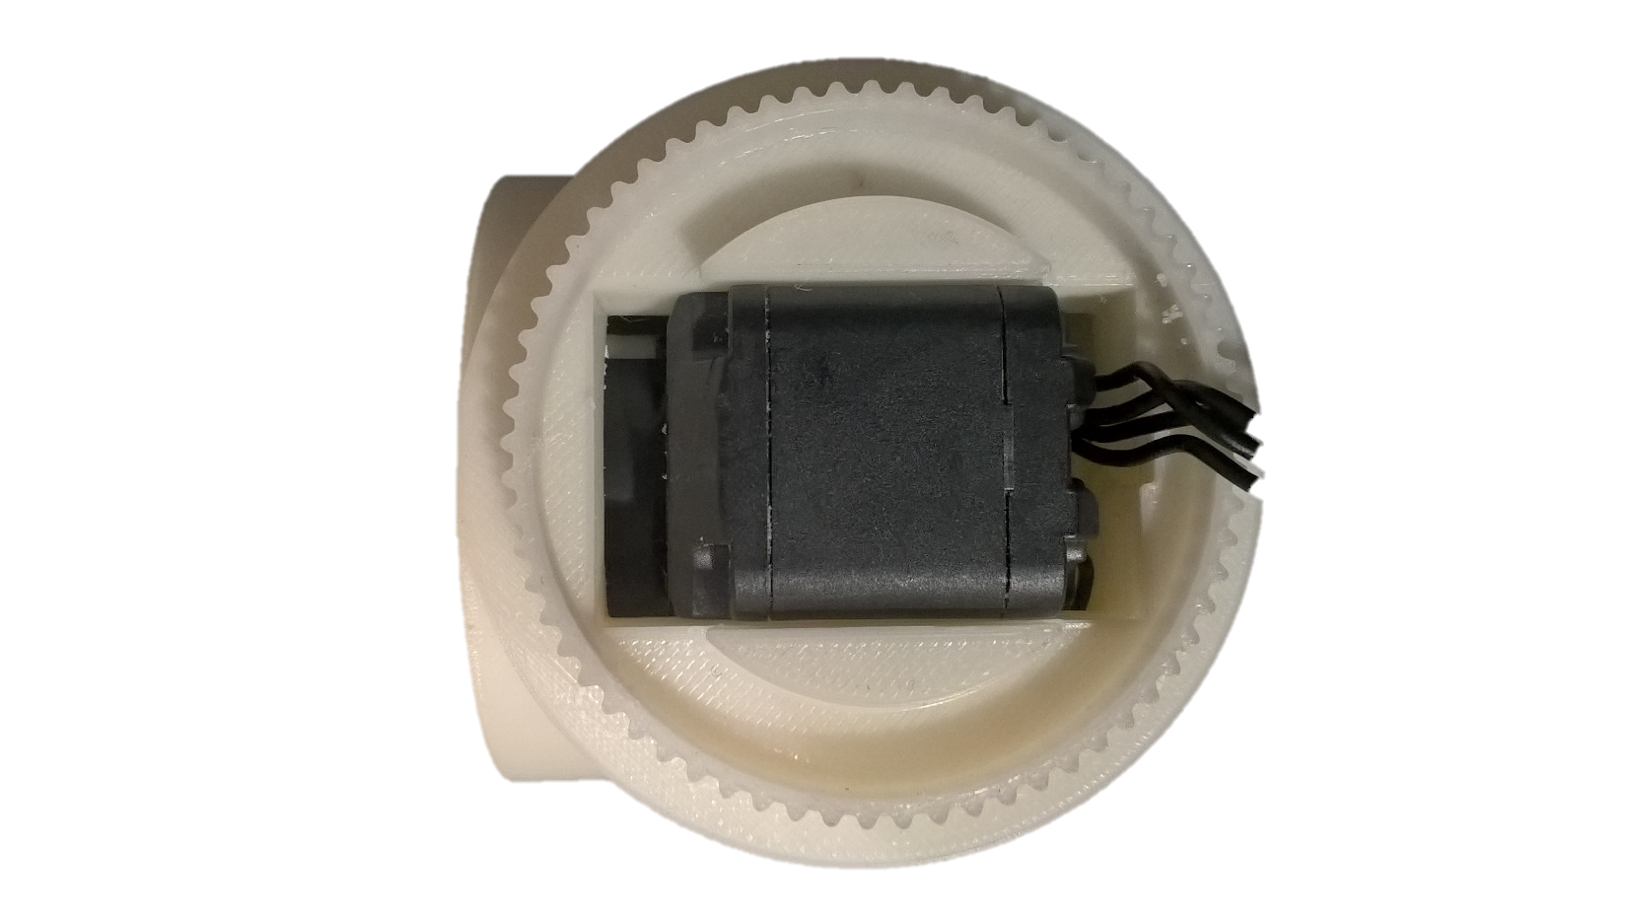

Slide 12
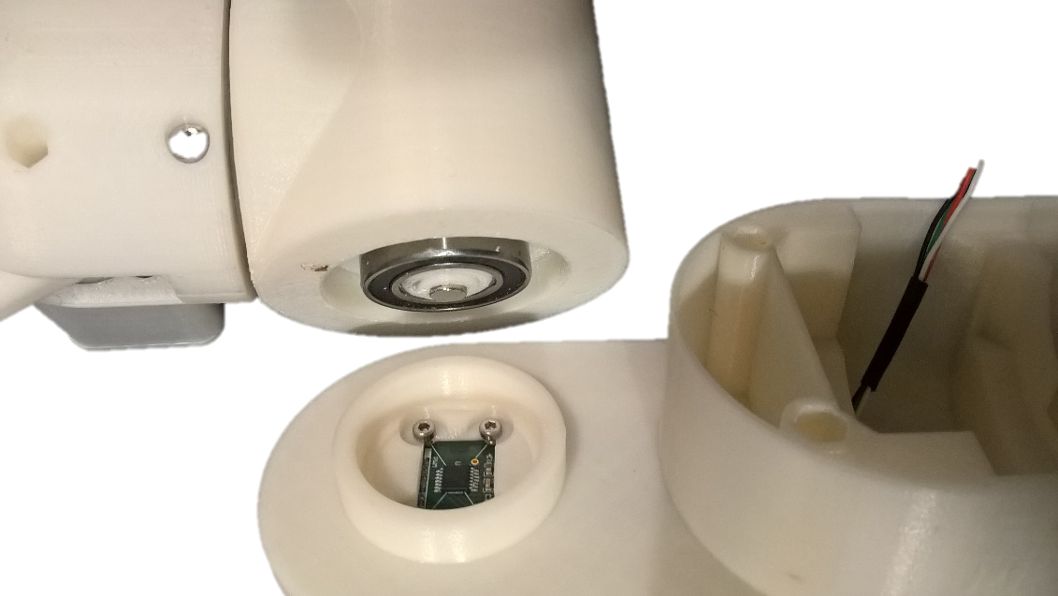
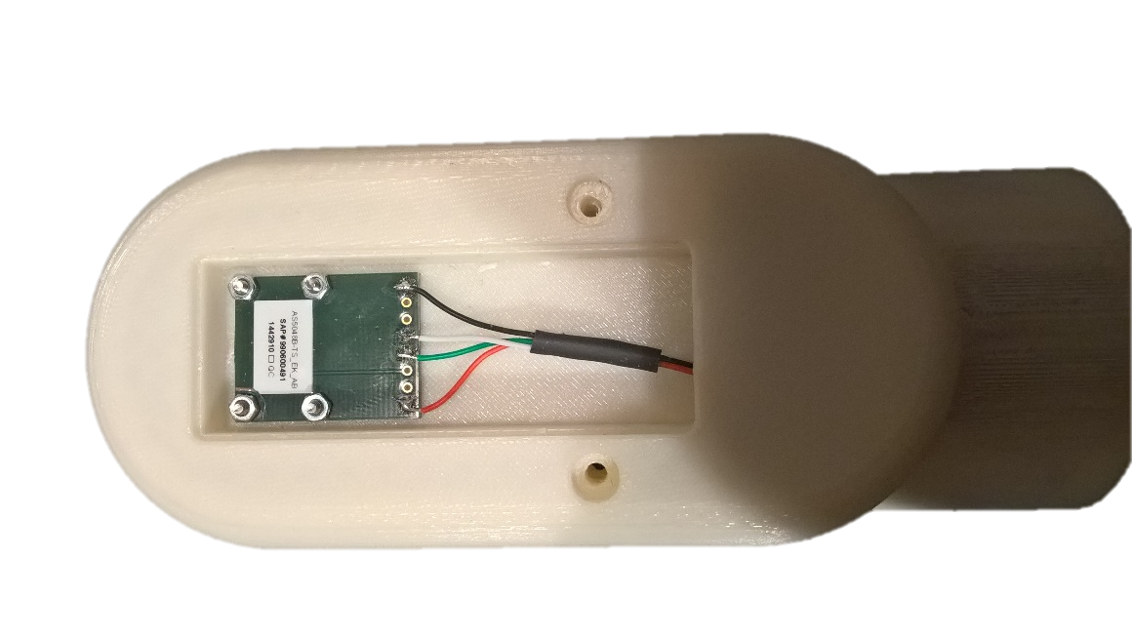
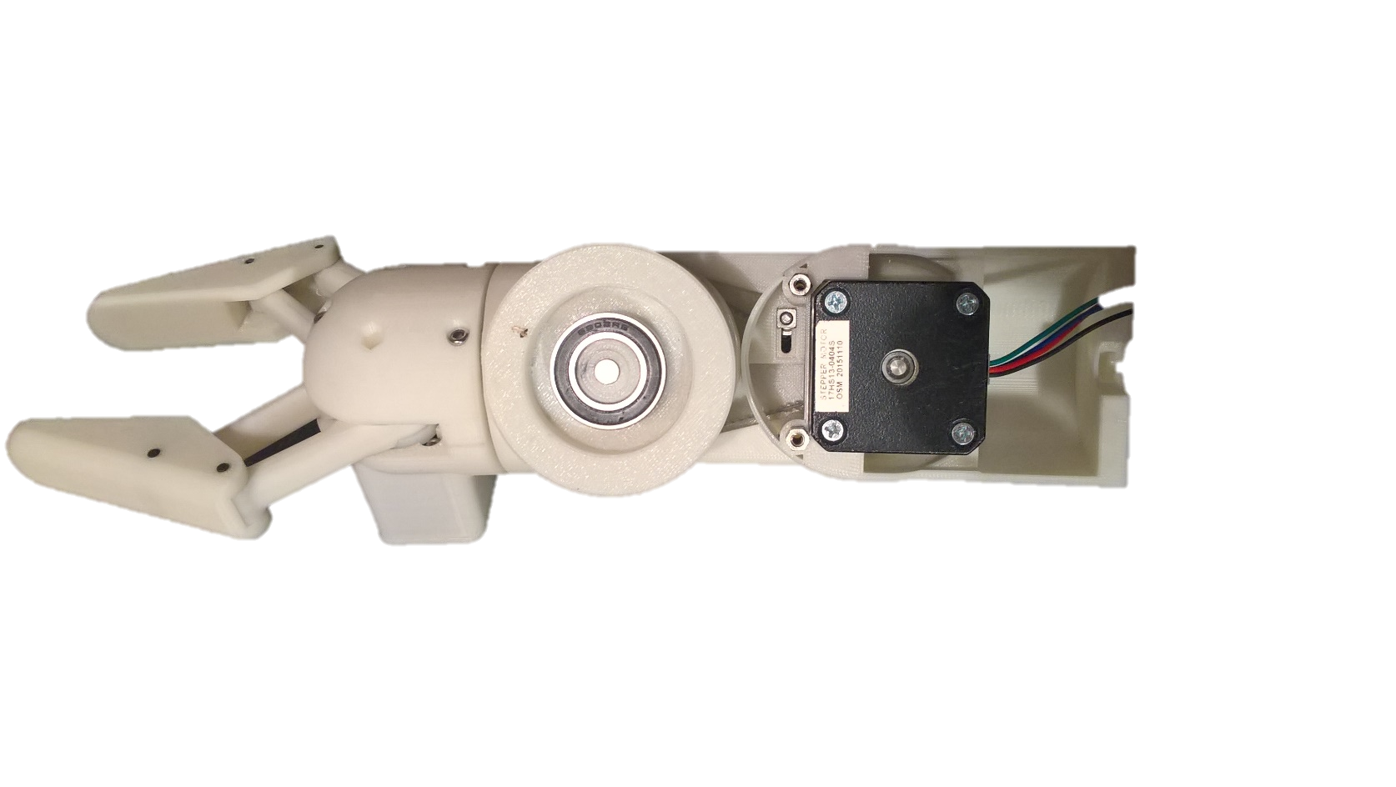
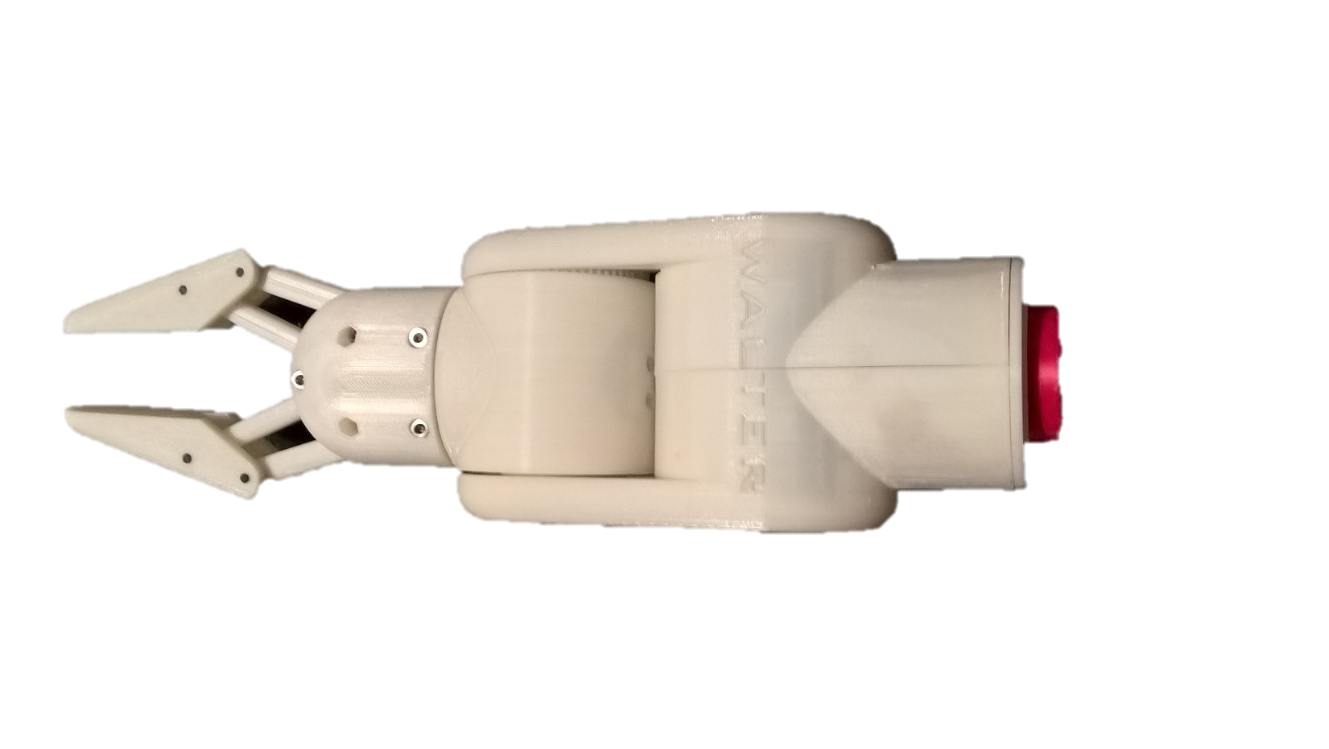

Slide 13
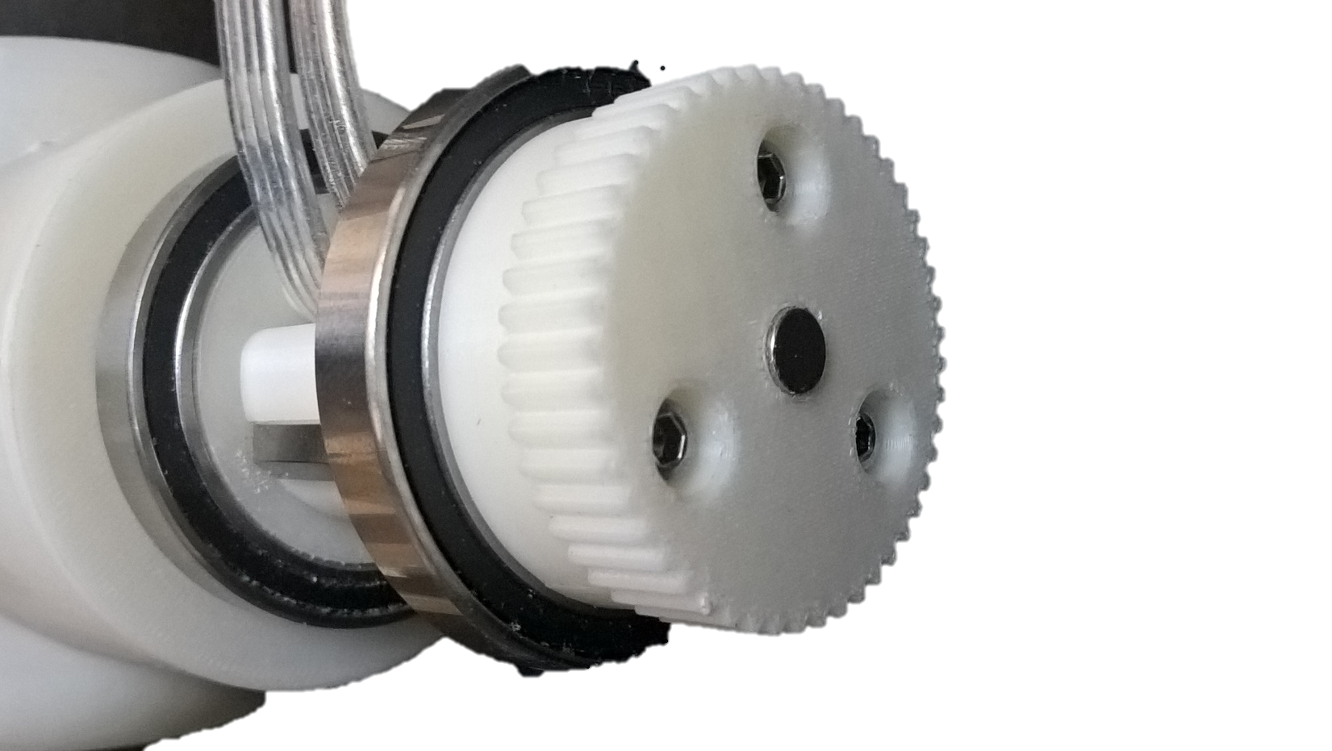
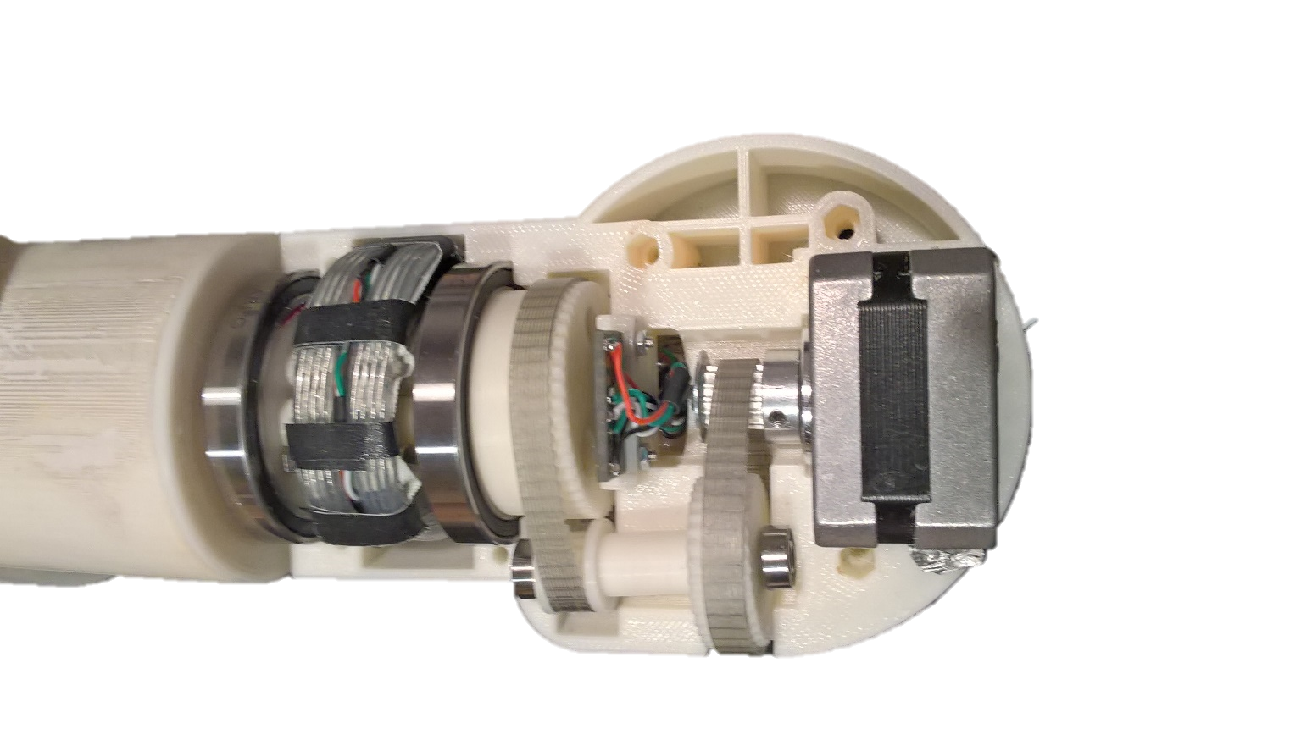
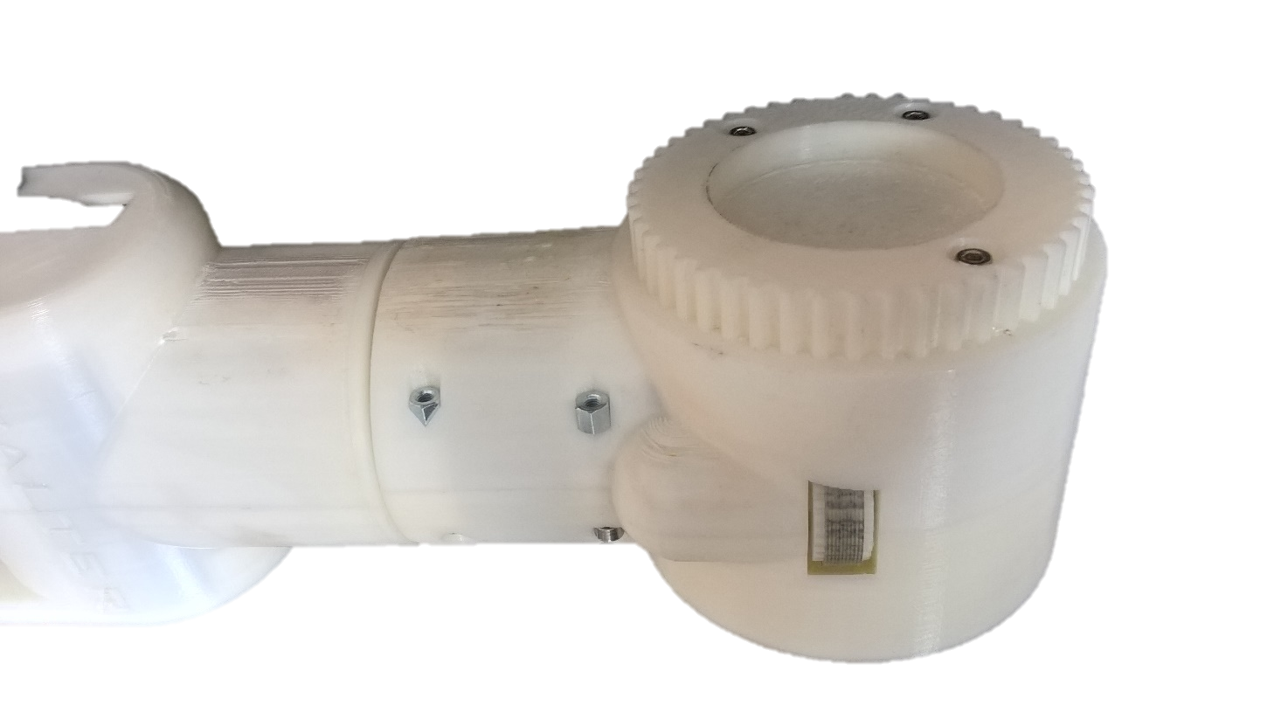

Slide 14
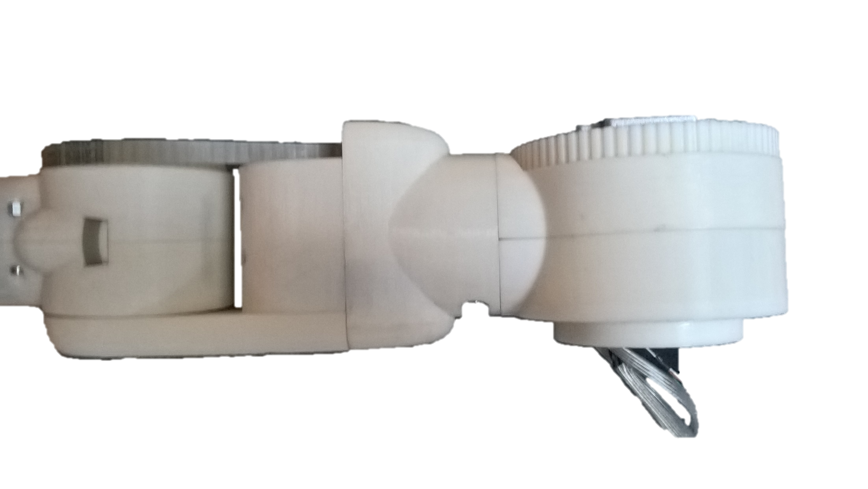
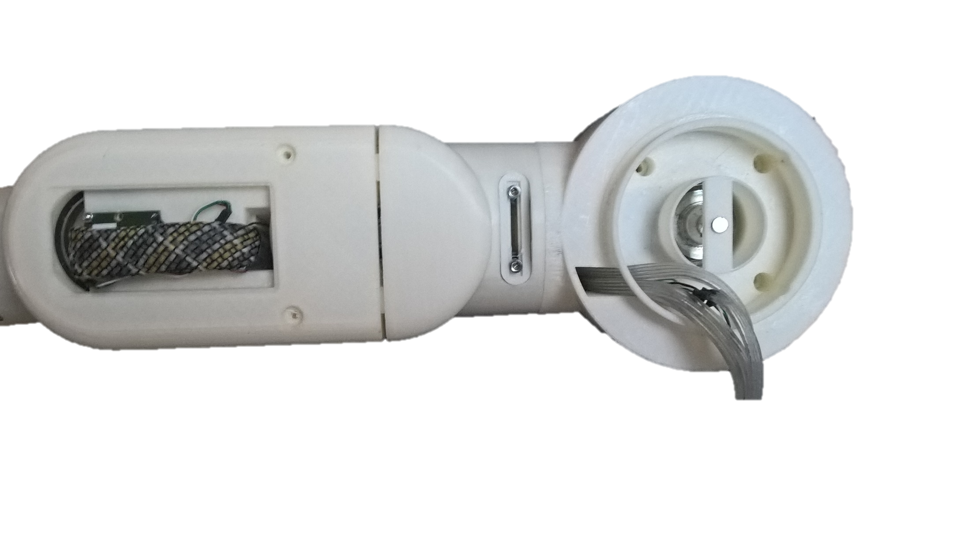
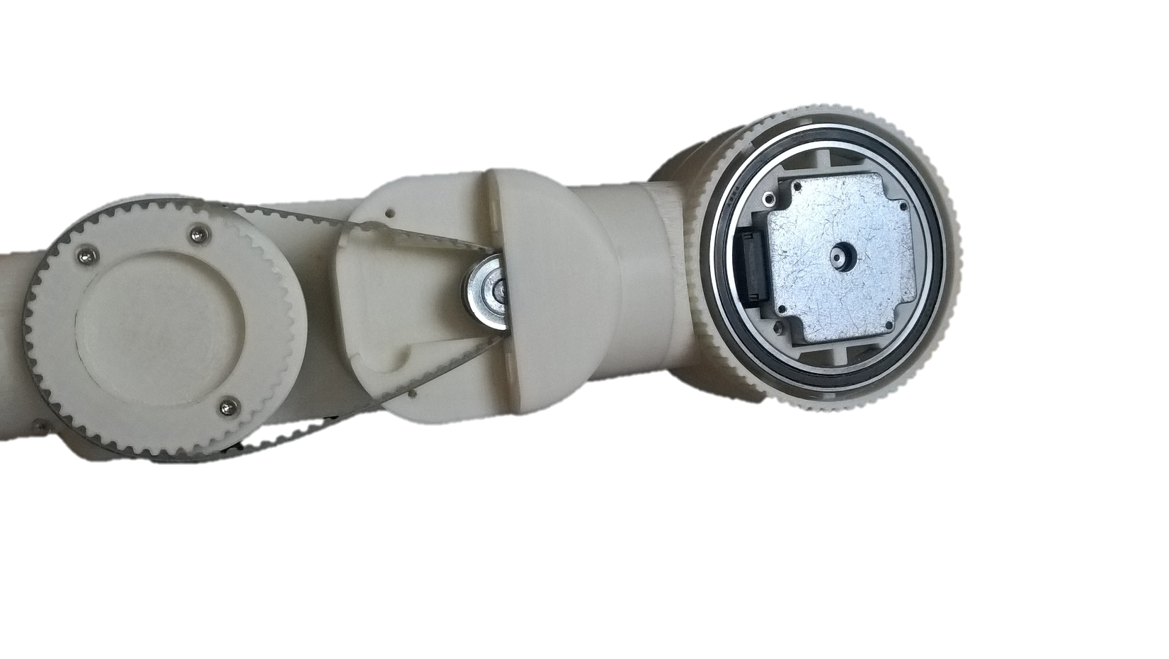

Slide 15
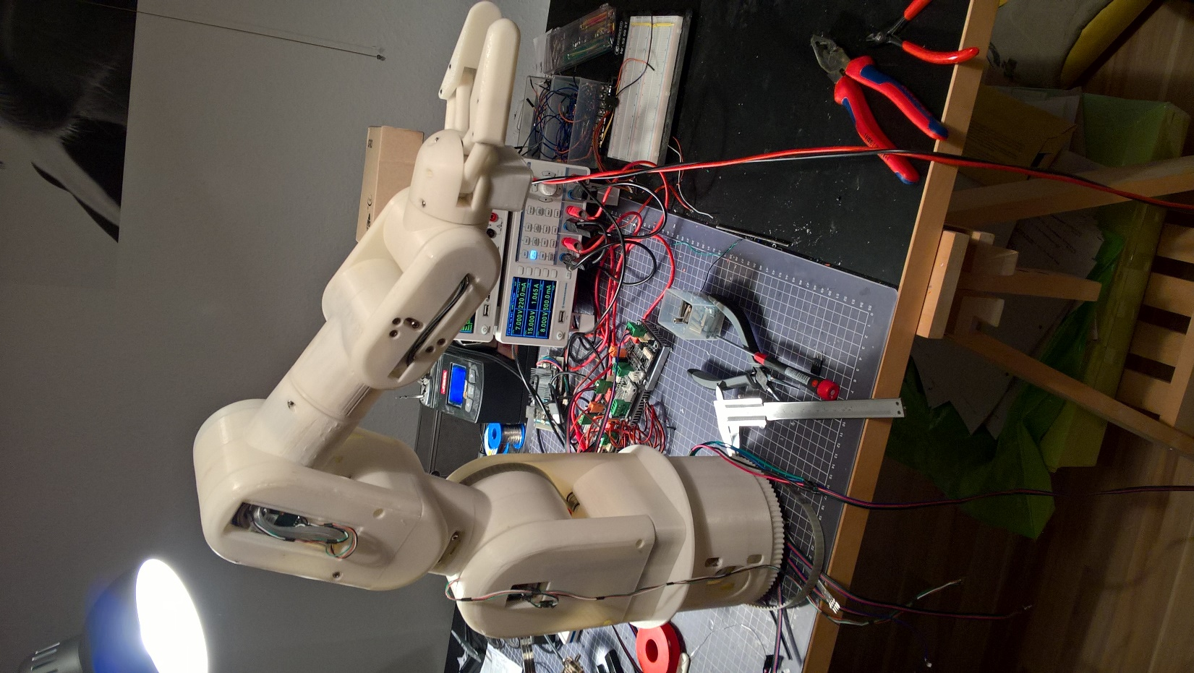
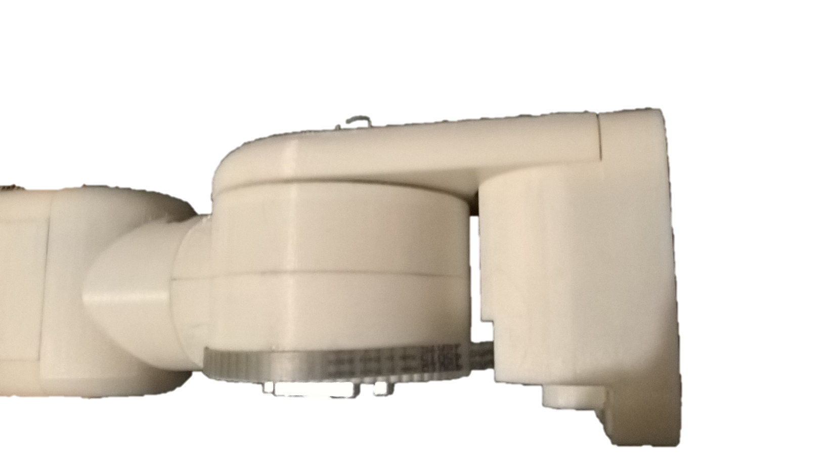
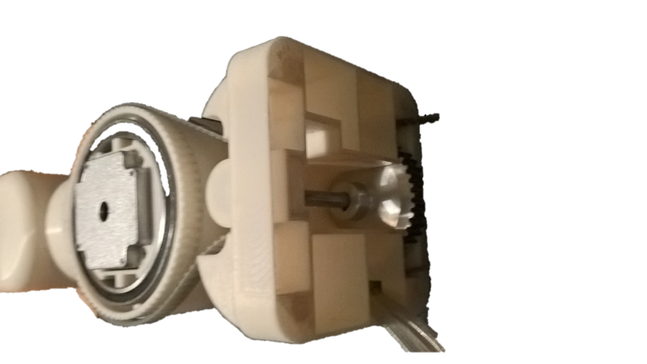

Slide 16
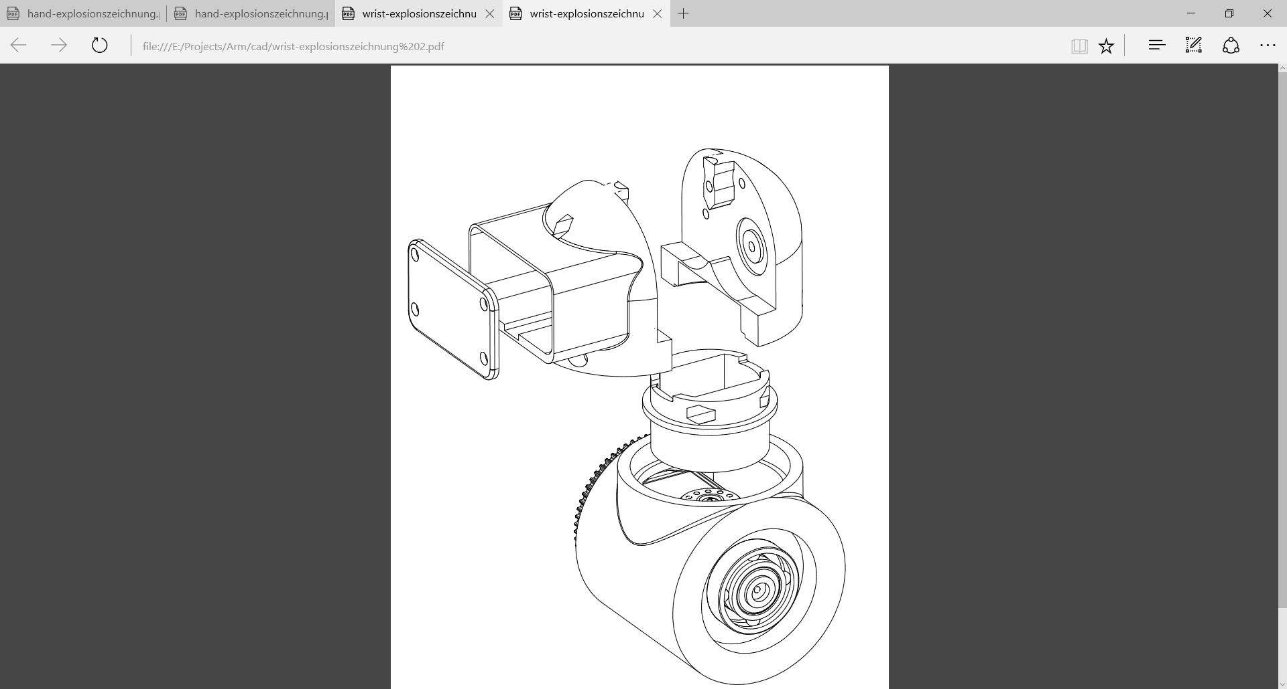
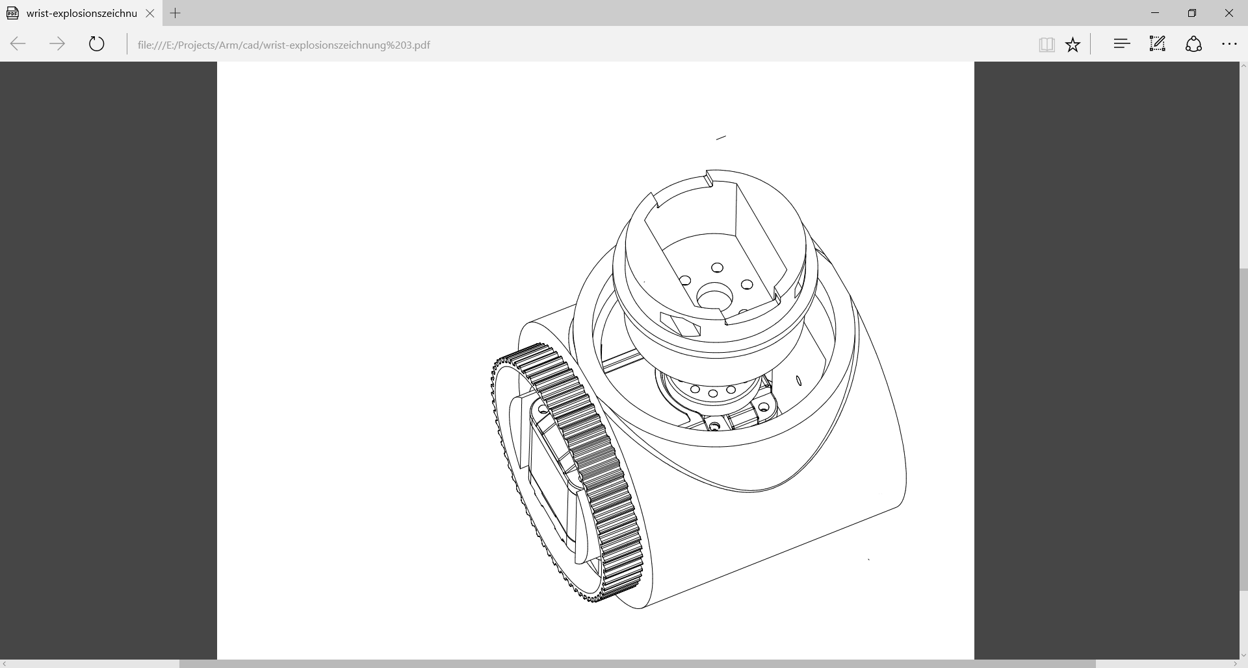
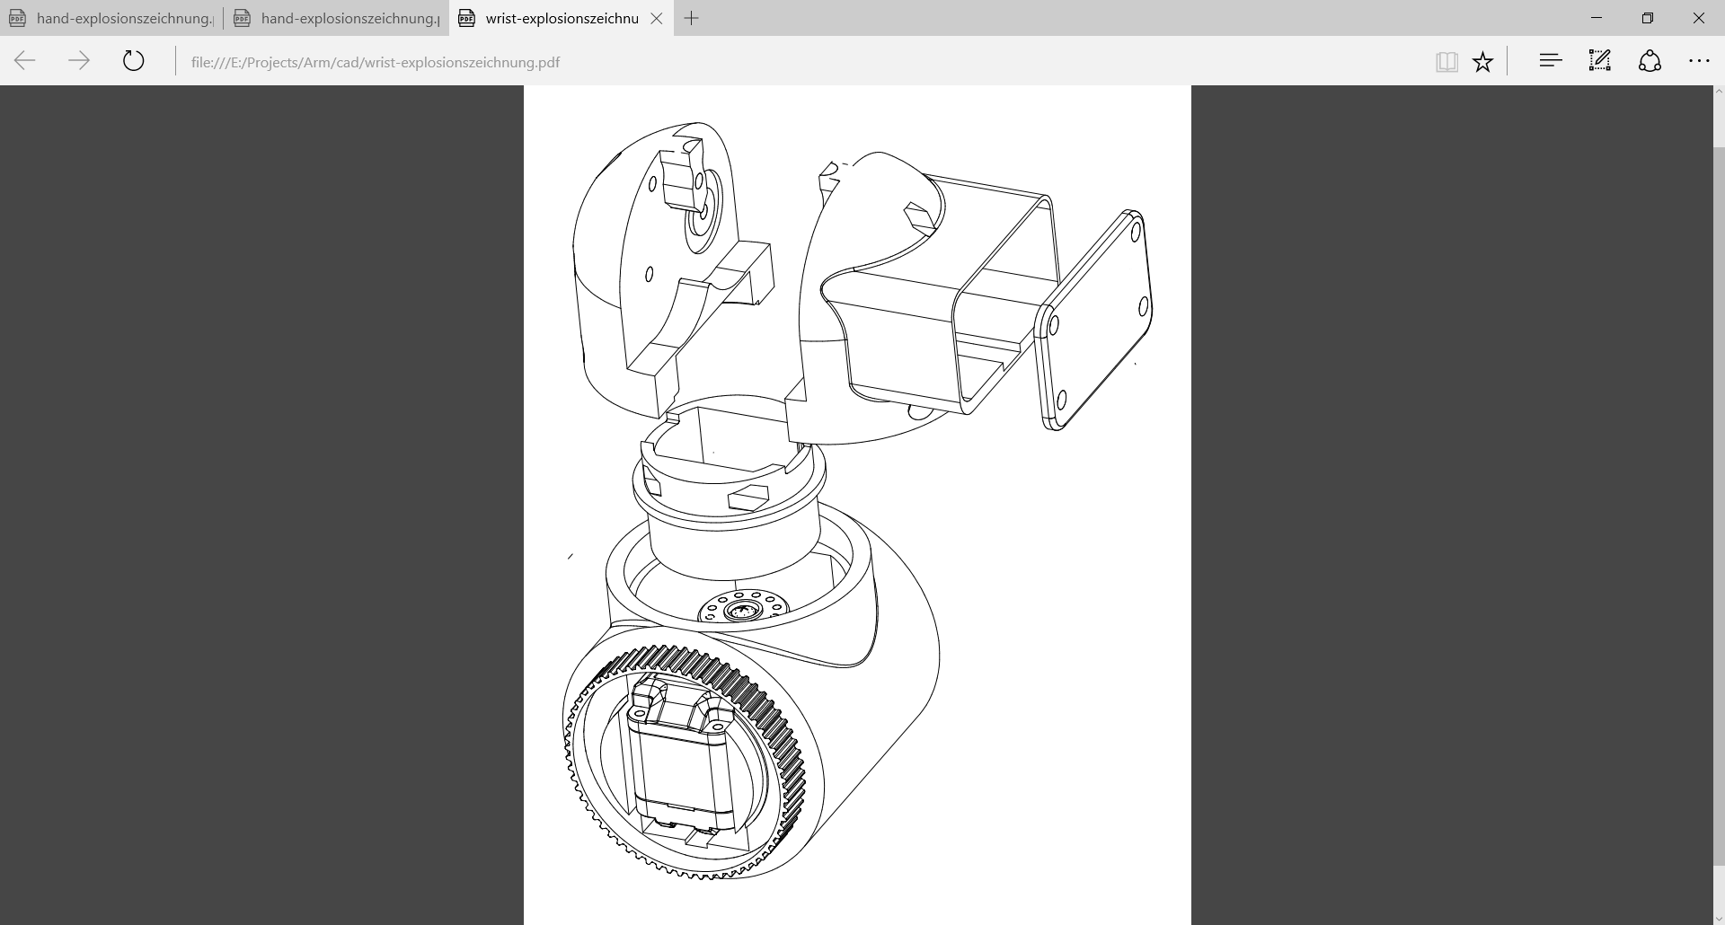

Slide 17
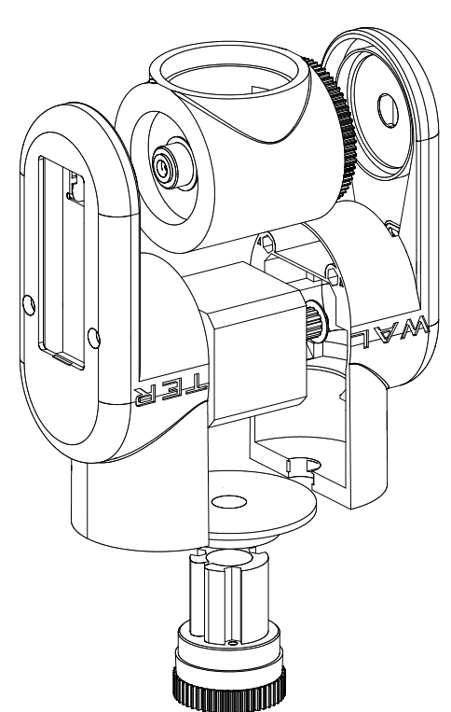

Slide 18
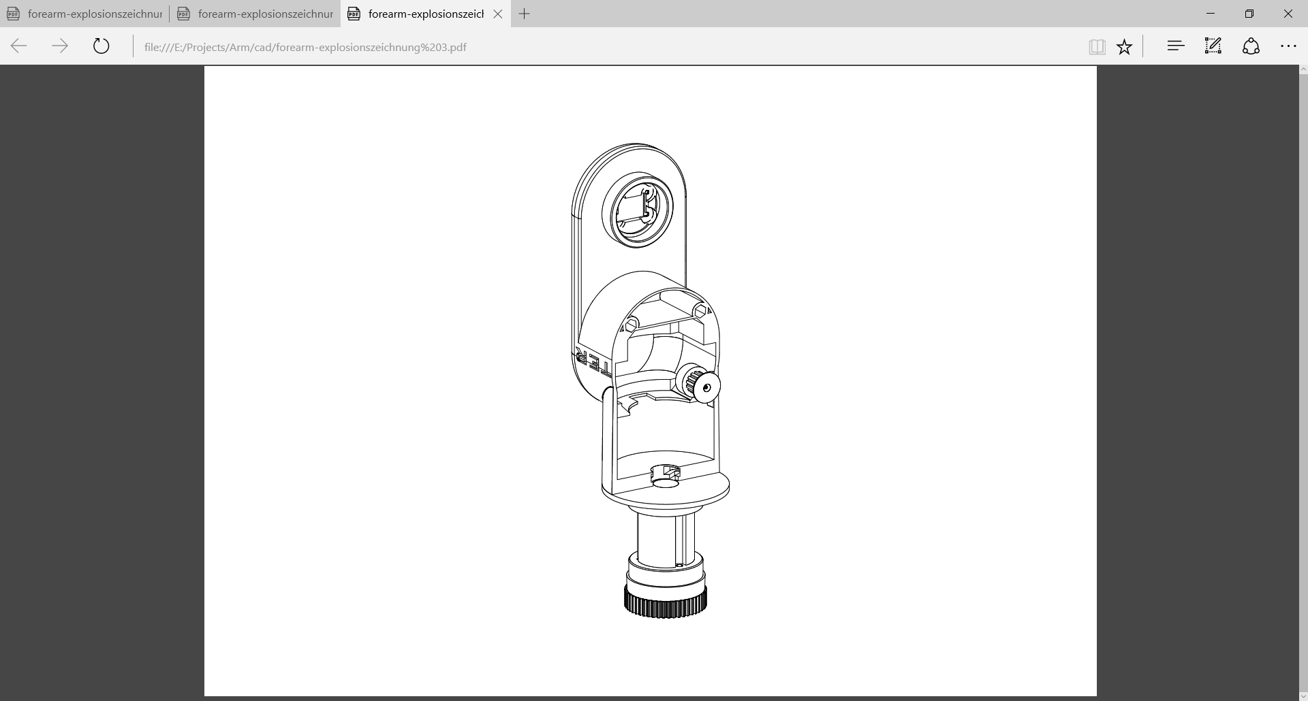
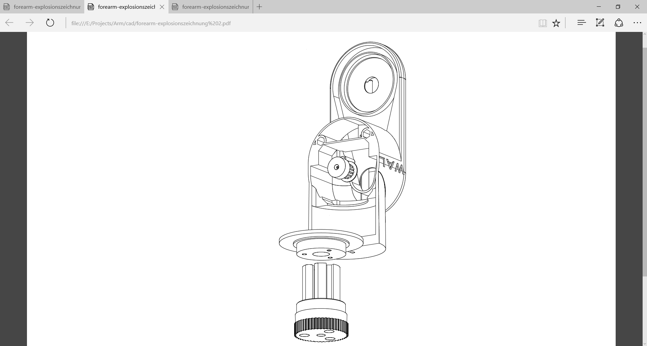

Slide 19
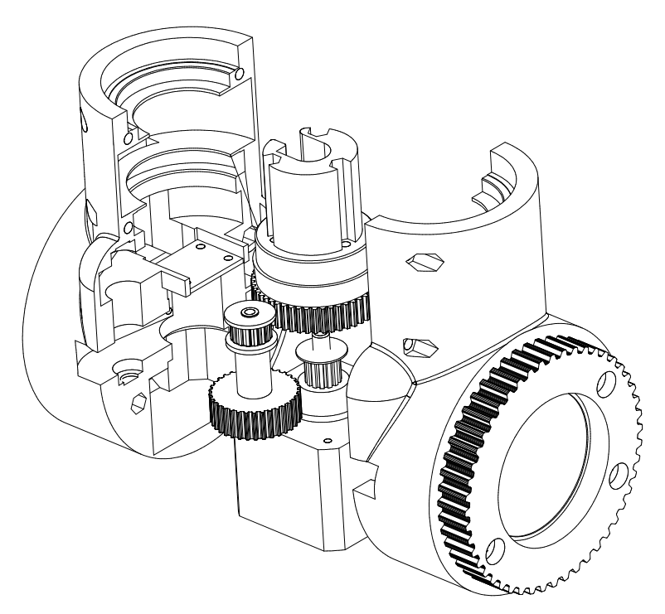

Slide 20
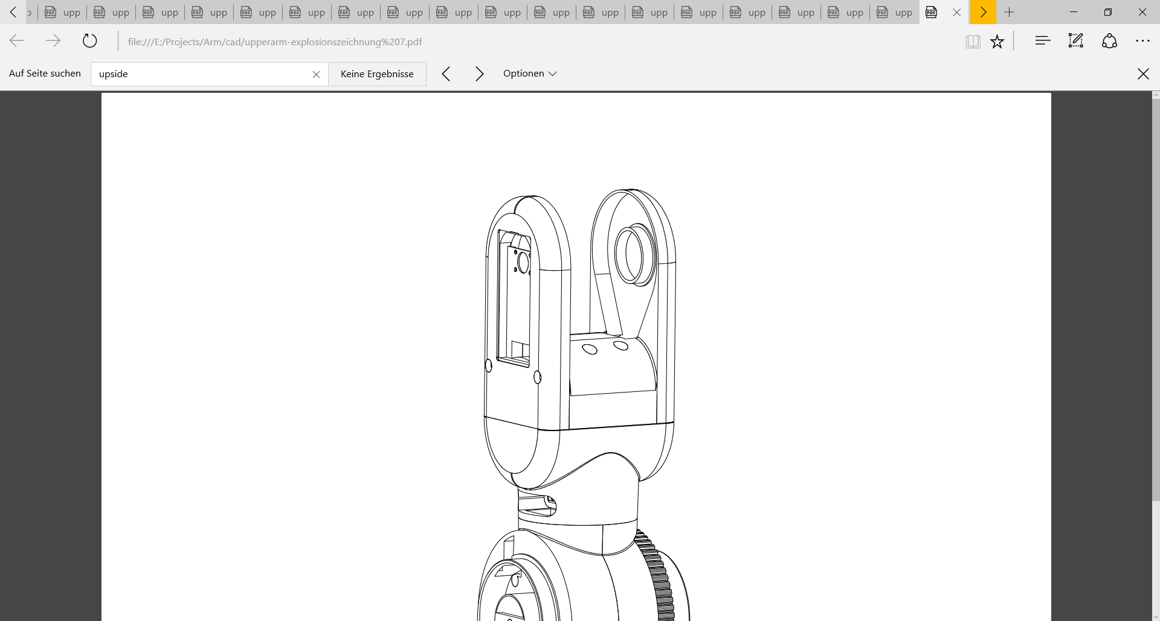
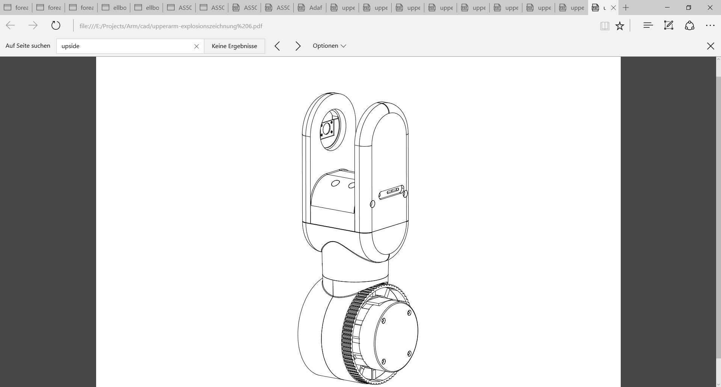
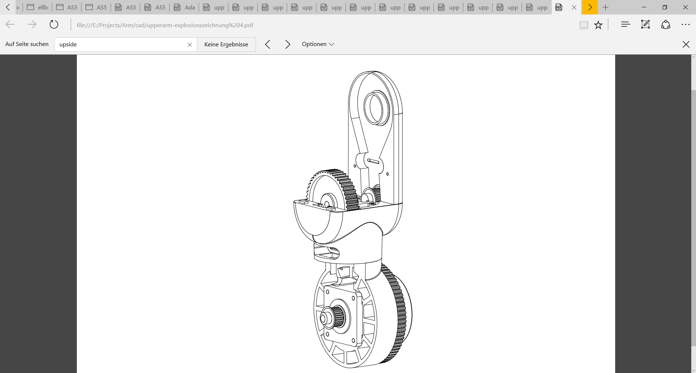
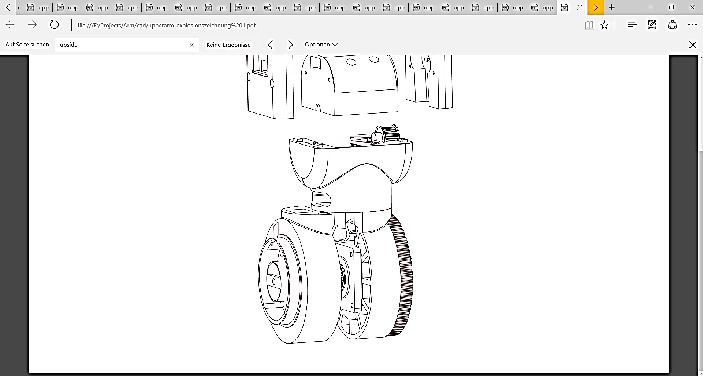

Slide 21
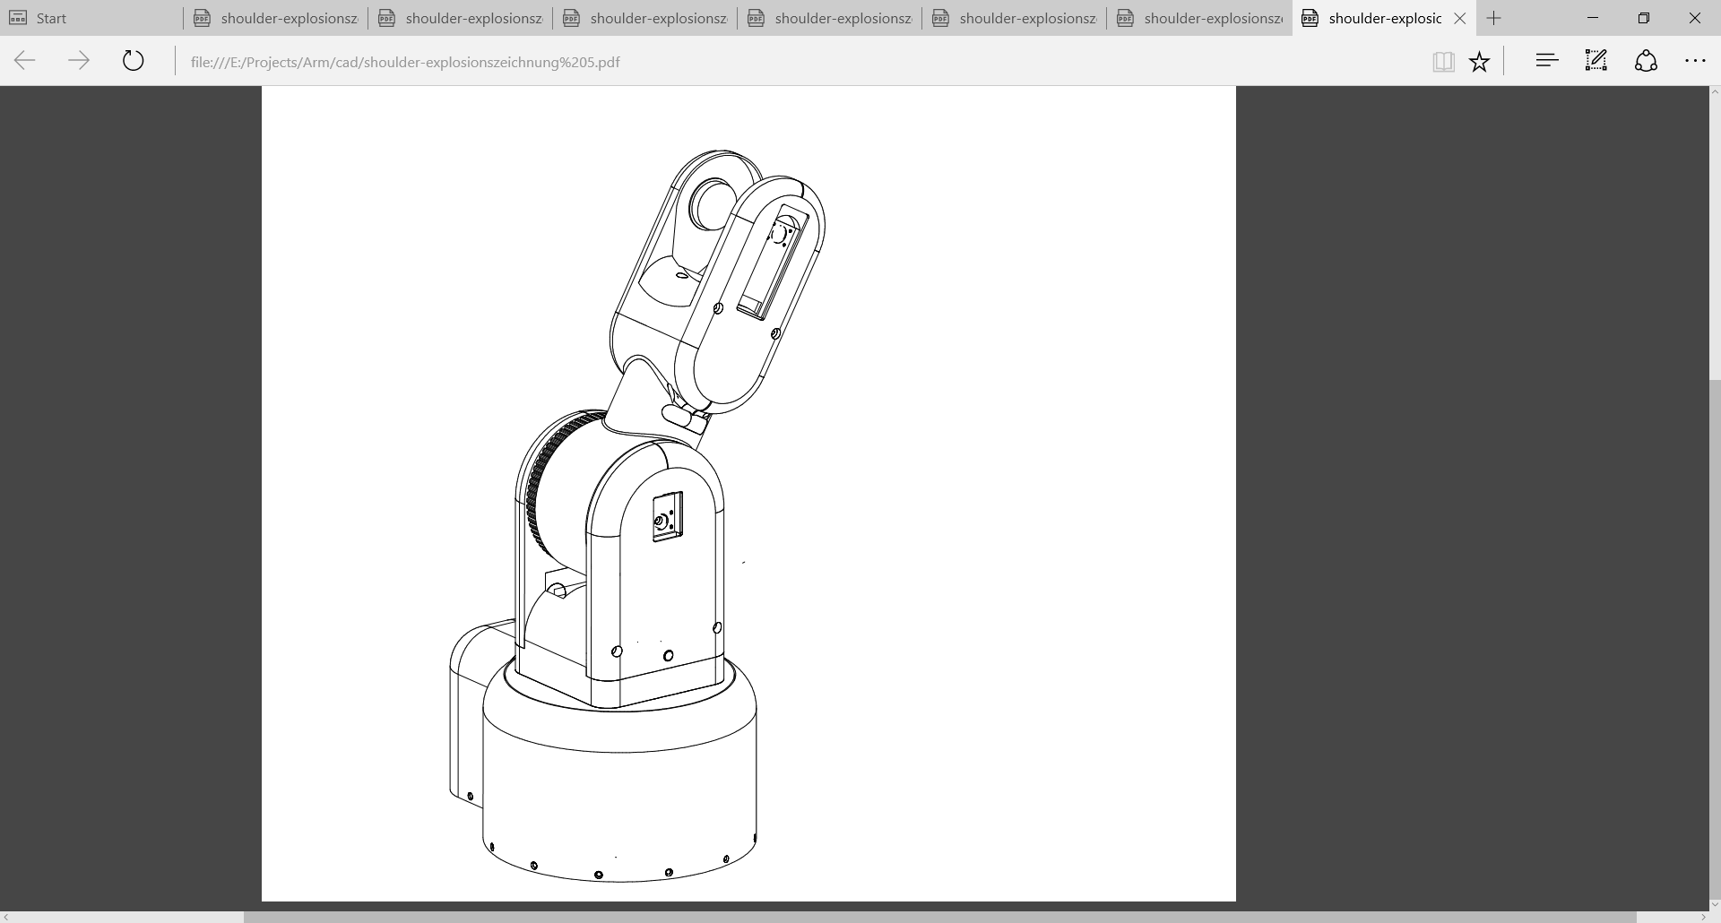
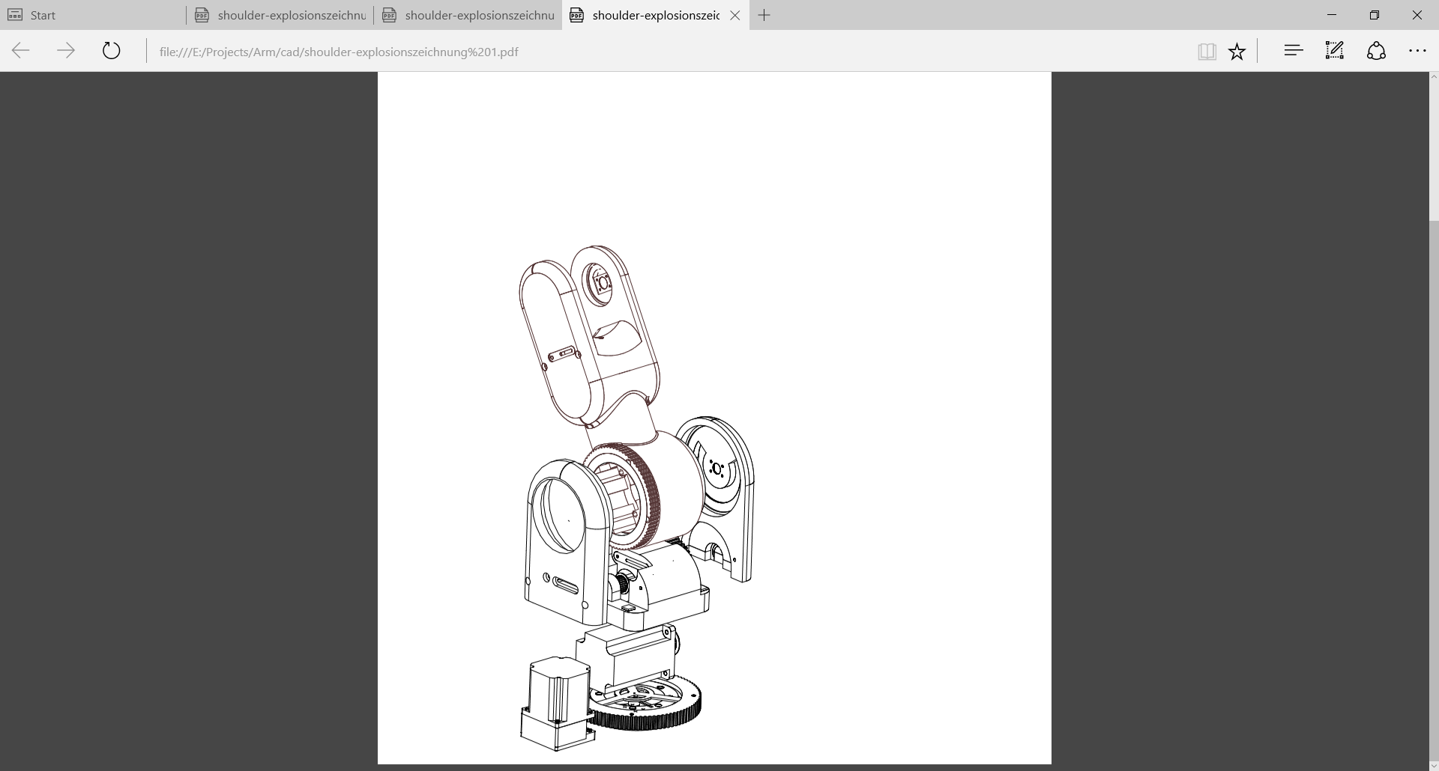
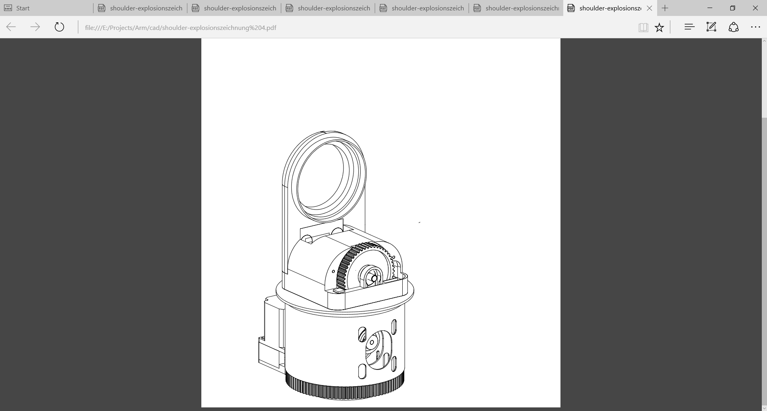

Slide 22
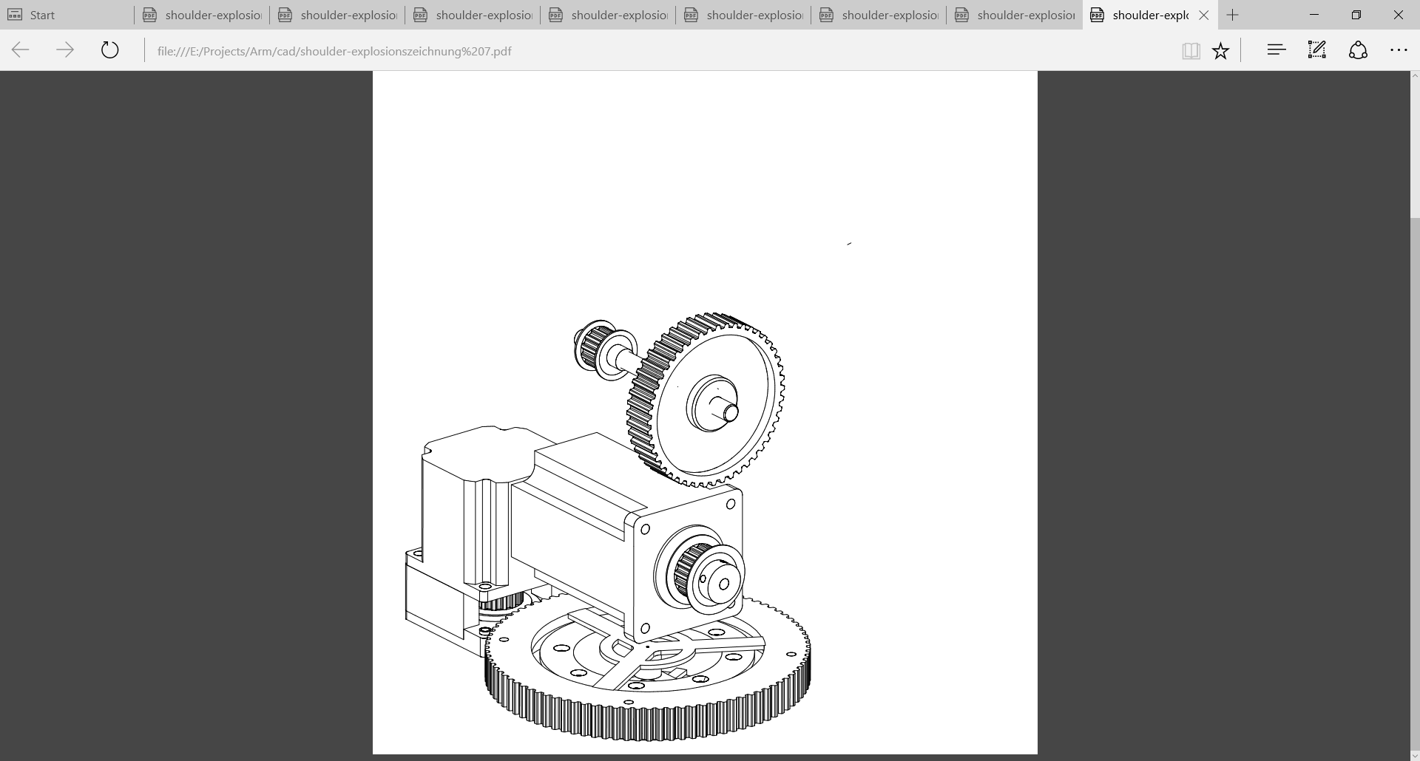
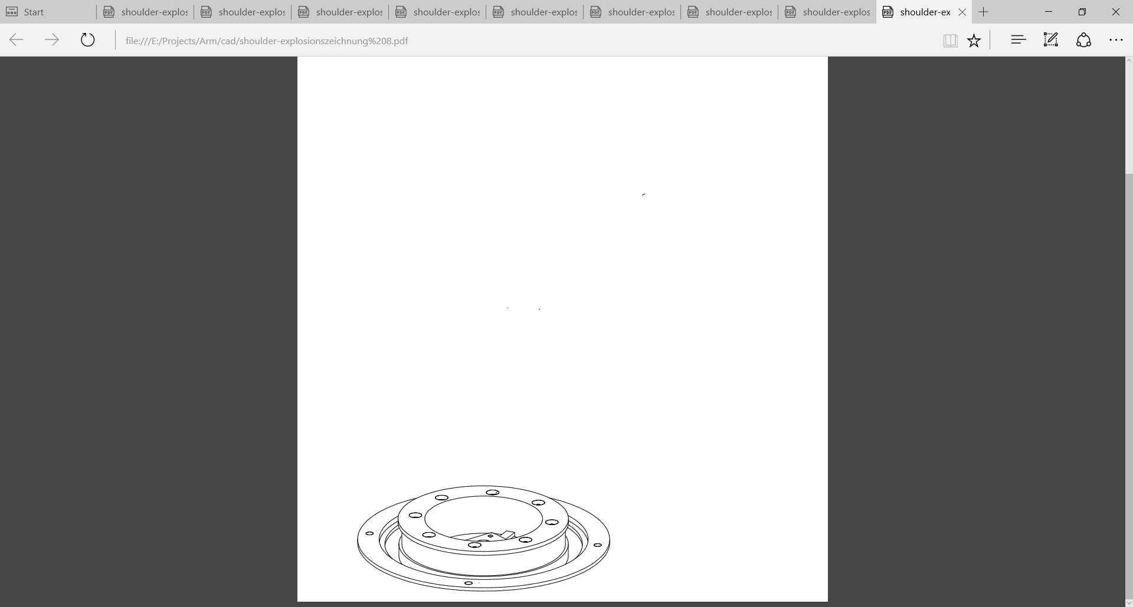

Slide 23
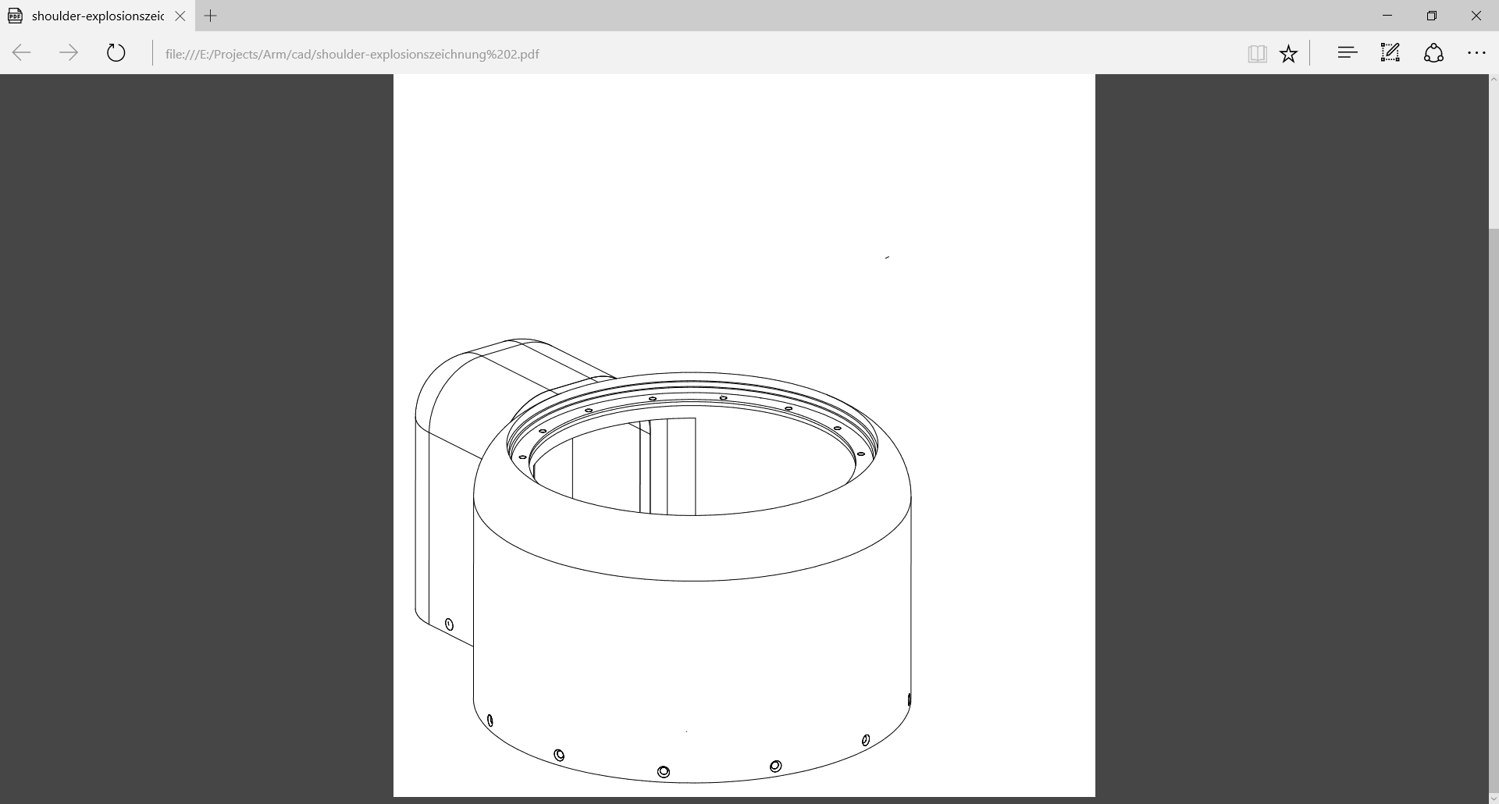
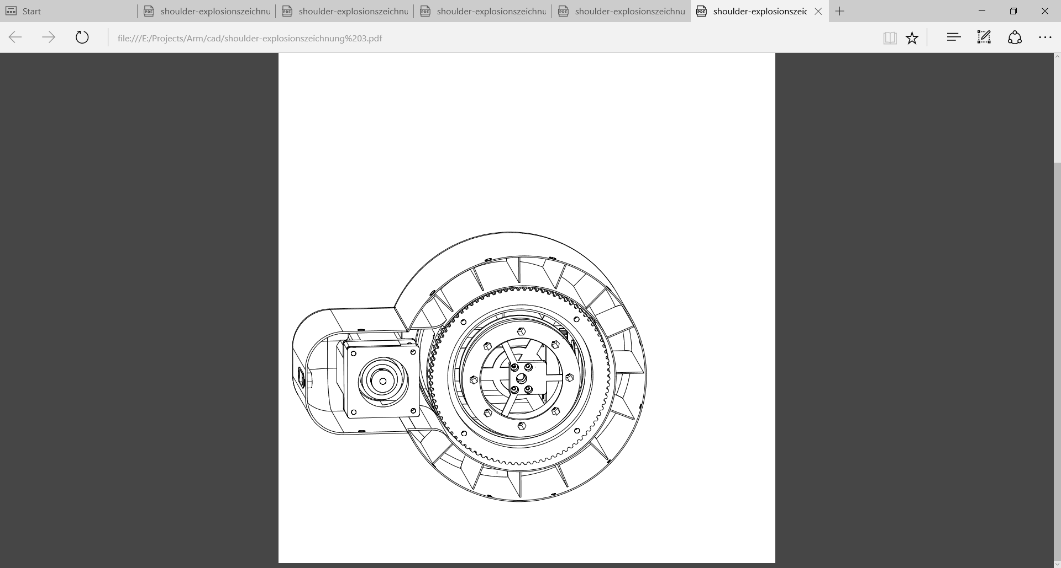

Slide 24
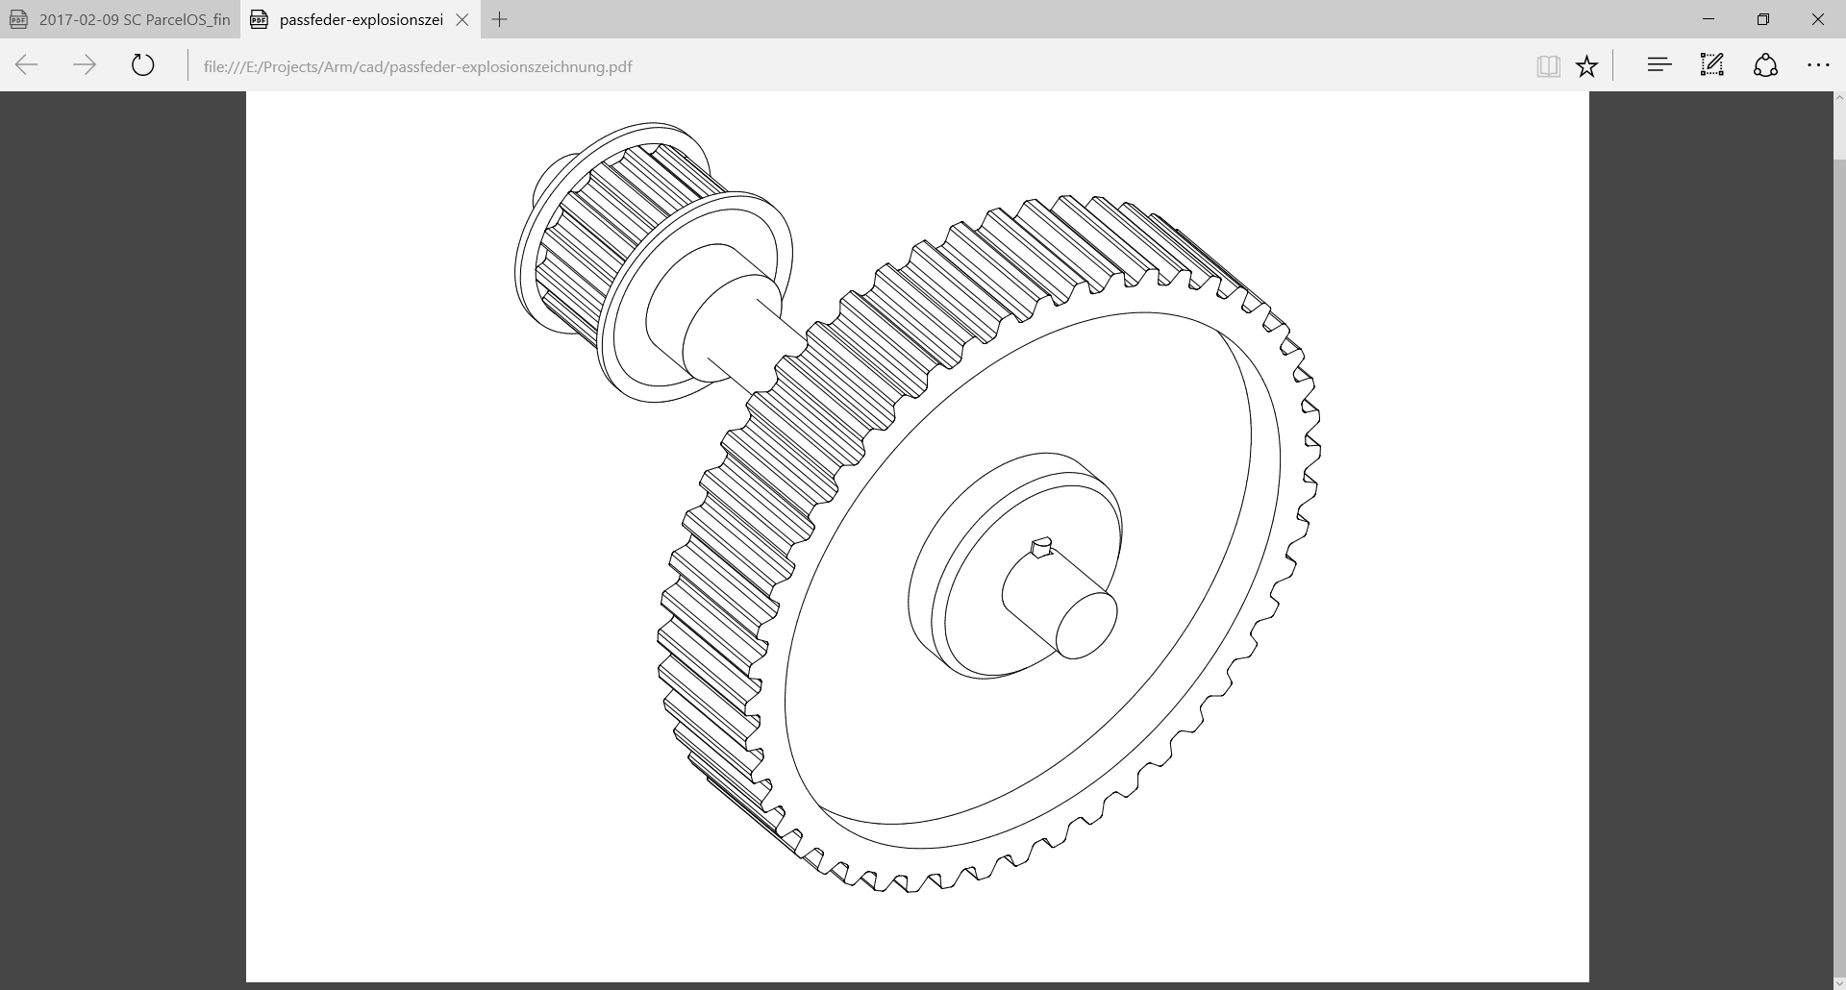

Slide 25
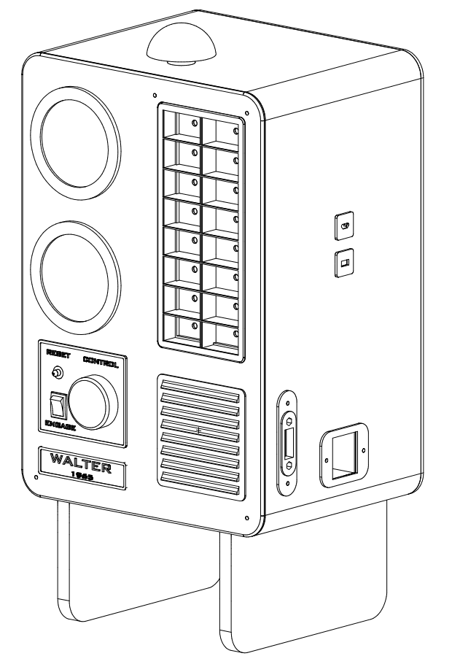

Slide 26
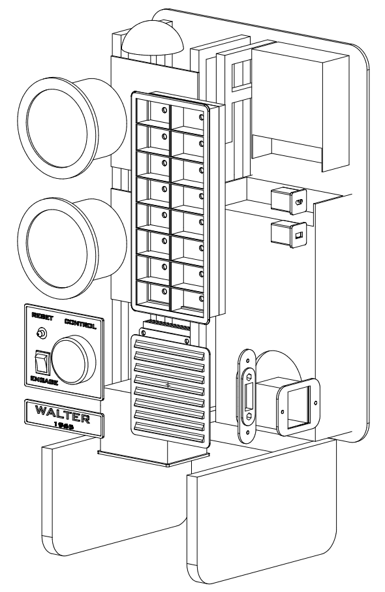

Slide 27
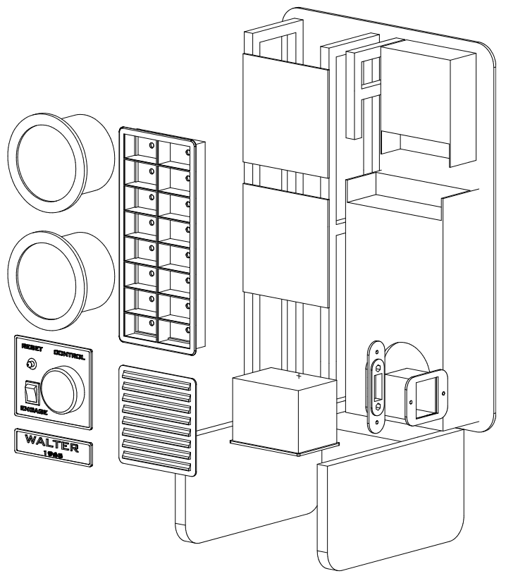

Slide 28
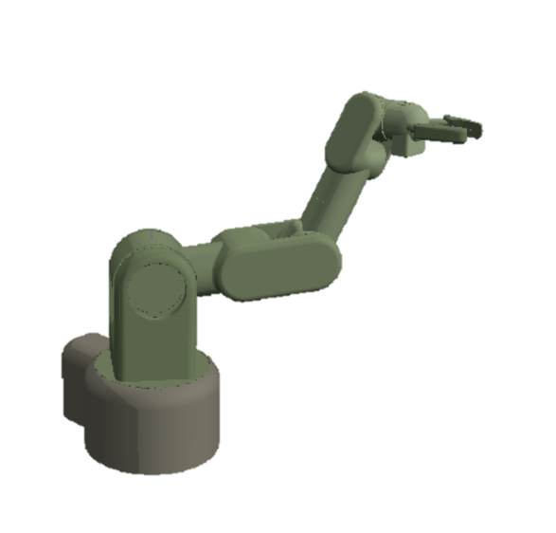
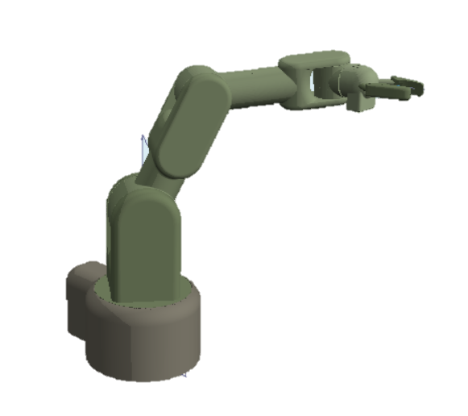

Slide 29
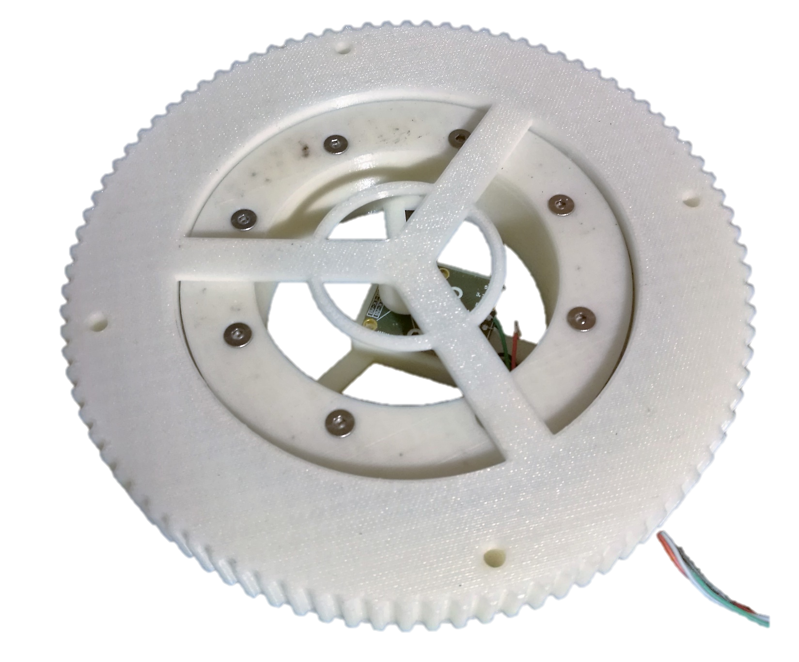
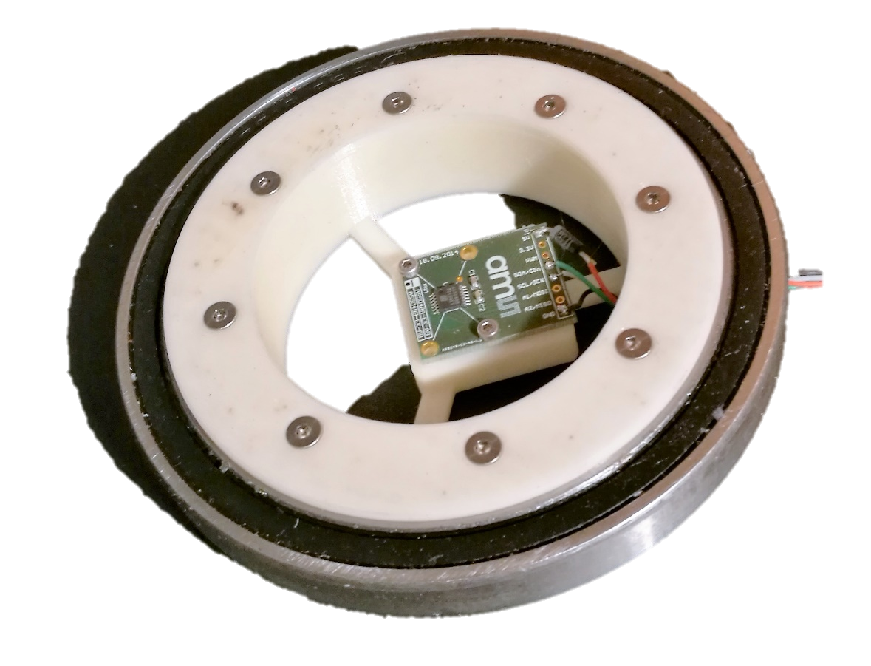

Slide 30
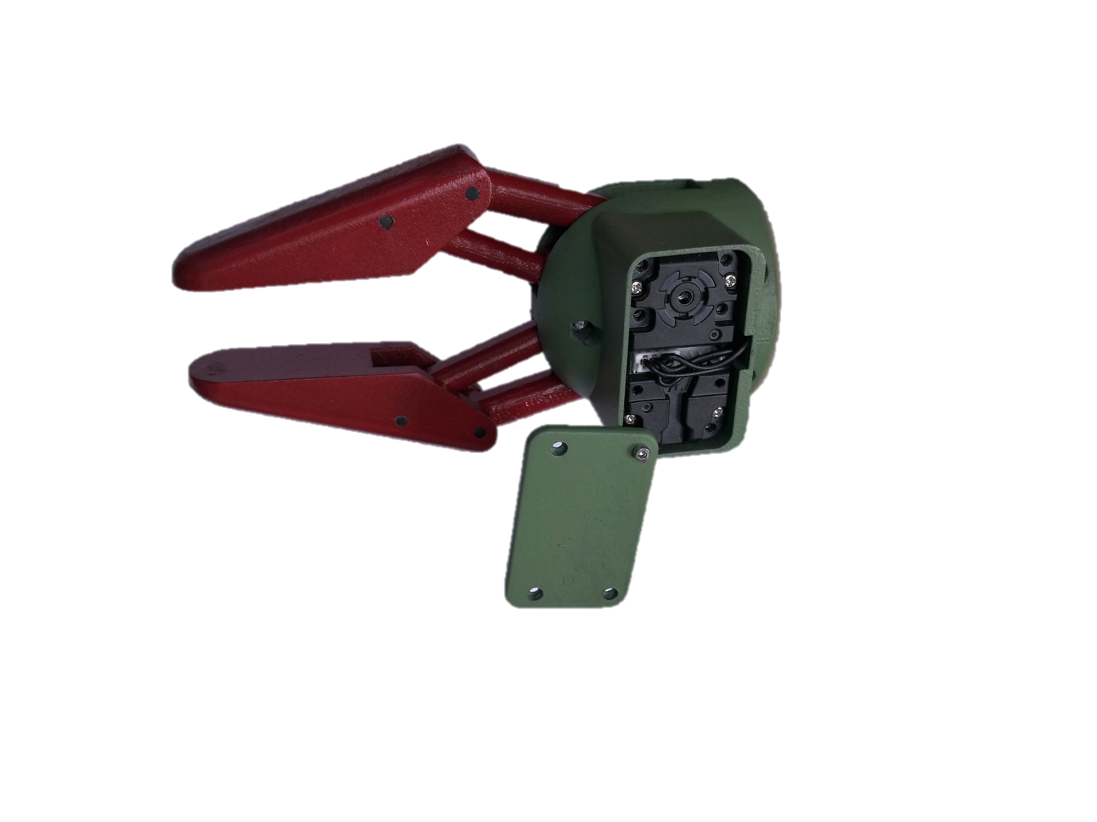



Slide 31



Slide 32




Slide 33




Slide 34



